Slide 1
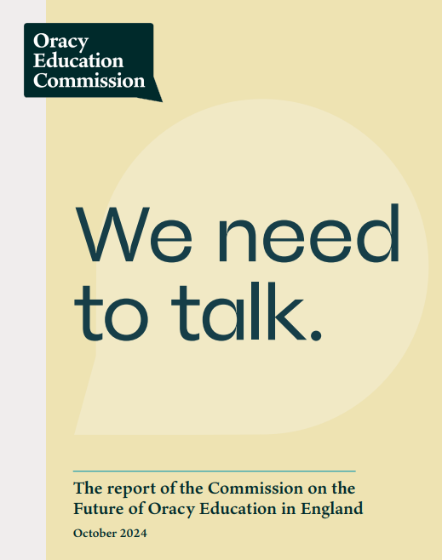
Oracy Commission Report
Journal Club No. 15
Autumn Term 2024
Presentation by Paula Lobo

Slide 2
Context and purpose of the Oracy report
High on the government (under Keir Starmer) agenda, to help remove inequality in life chances.
Builds on the Bullock Report of 1975, and other scholarship, which made the ground-breaking case for speaking and listening across the curriculum.
Builds on research work of teachers working to raise the profile of oracy in education
There will be no ‘national strategy’ or intervention that needs to be shoehorned into a packed curriculum.
Intention is to move oracy more centrally into all stages of education: for oracy to become the fourth ‘R’ (alongside reading, writing and arithmetic), an essential, foundational building block to support our young people on their journey towards living fulfilling adult lives.

Slide 3
Research base
Met five times in April – September 2024
Received 94 submissions of written evidence
Curated 58 Commission Conversations, with experts such as Counsell
Considered international comparisons & case studies of school practice
Oracy education is the intentional cultivation of the ability to articulate ideas, develop understanding and engage with others through speaking, listening and communication. It comprises three interrelated components:
﻿﻿﻿Learning to talk, listen and communicate: the development of children's speaking, listening and communication skills.
﻿﻿﻿Learning through talk, listening and communication: the use of talk or dialogue to foster and deepen children's learning.
Learning about talk, listening and communication: building knowledge and understanding of speaking, listening and communication in its many contexts.
Definitions

Slide 4
Component 2: Learning through talk
﻿﻿Dialogic teaching is a pedagogy of the spoken word which harnesses the power of talk to stimulate and extend students' thinking, learning, knowing and understanding, and to enable them to discuss, reason and argue
﻿﻿Dialogic teaching approaches involve teachers extending students' thinking and understanding through talk; it requires skilled teachers who can balance productive dialogue, critical thinking, and respectful interaction (training?)
﻿﻿Help students critically and constructively interact with each other's ideas; students benefit from support and structures to develop understanding of what exploratory talk is like.
﻿﻿Use talk-based teaching approaches, such as storytelling and storymaking in Drama

Slide 5
Component 1: Learning to talk
Oracy is also a curricular goal in its own right: the intentional development of young people's skills in using spoken language, similar to the explicit teaching of algebra in maths or drawing in art.
﻿﻿Identifying a set of oracy skills which transcend subjects can be helpful to support senior leaders to evaluate how well their wider curriculum supports their students to develop a rich repertoire of speaking and listening
﻿﻿The study of speech and debate (perhaps through the study of rhetoric) is a key aspect of oracy education. Students should learn how arguments can be evaluated; learning how to argue and reason verbally has benefits across all curricular learning, and to active citizenship both at school and in later life.

Slide 6
Component 3: Learning about talk
Language is a rich and dynamic area of study drawing on technical, cultural, political, historical, geographical and psychological influences. Yet, since the removal of the Spoken Language Controlled Assessment in English Language GCSE, there are few opportunities for students to engage in the study of spoken language.
Studying spoken language can empower students to make informed choices about their language and communication and understand the impact of these choices.
Children and young people should learn about listeners’ perceptions and consider how race, class, and other speaker characteristics influence what we hear and why.

Slide 7
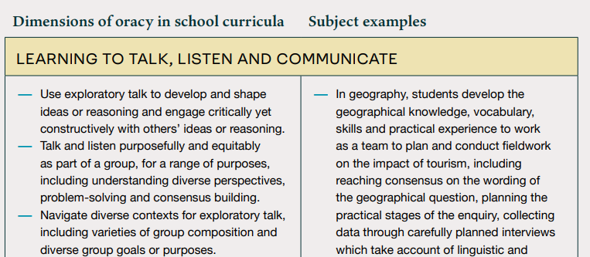
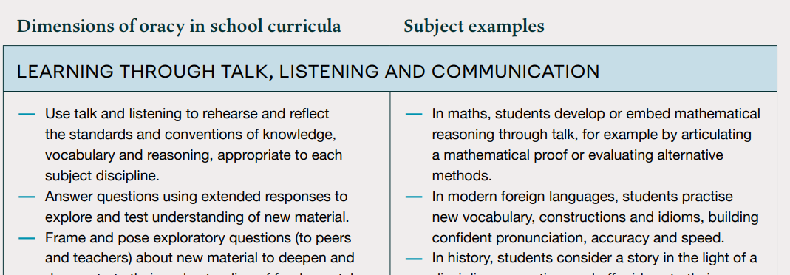
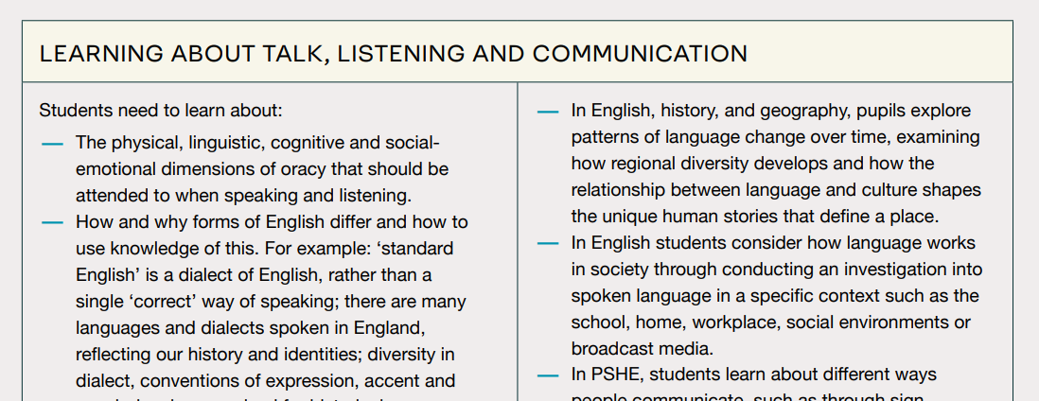

Slide 8
Report Recommendations
Make oracy a core aspect of education from early years to post 16, including:
  embedding an oracy ‘entitlement’ into curriculum requirements
  curating a broad curriculum (emphasising the value of expressive arts and English) as contexts for oracy
Build oracy into teacher training and development
Promote evidence-based approaches to oracy
Reflect the scope and value of oracy in assessment and accountability

Slide 9
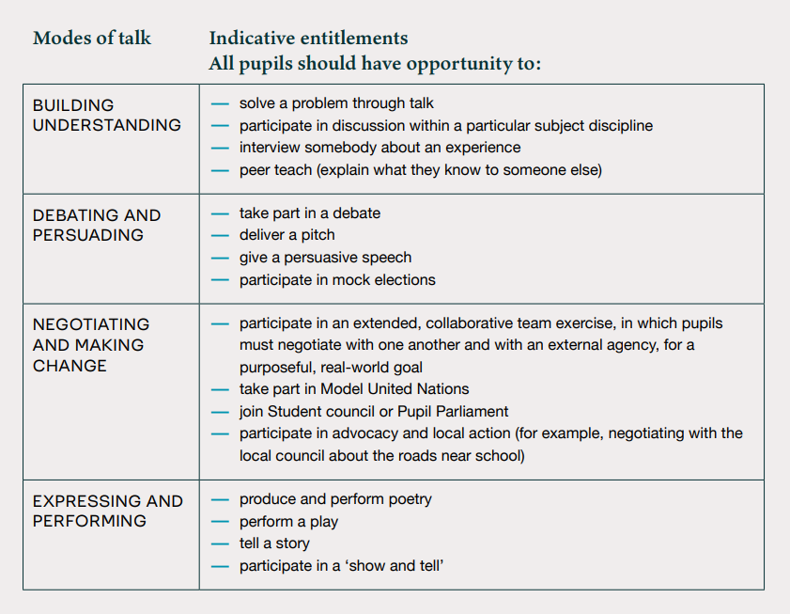

Slide 10
