Slide 1
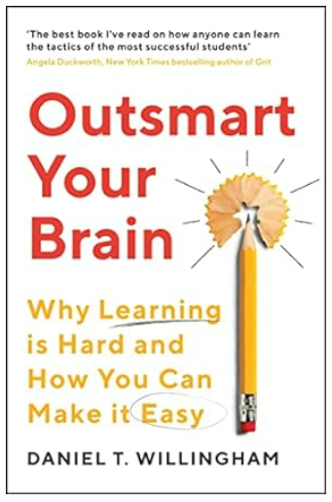
Outsmart Your Brain
Journal Club No. 12
Autumn Term 2023
Presentation by Paula Lobo

Slide 2
STOPPING DISTRACTIONS
Psychologists Angela Duckworth and James Gross have described four mental steps that apply to distraction:
  a student arranges for her phone to be with her while studying
  next, the student shifts her attention to her phone when it pings;
  third, she evaluates the notification as important;
  fourth, she responds by going on Snapchat.
The presence of the internet is so distracting that you'd be wise to take notes longhand in most circumstances. When I work on my computer, if I can see open tabs, documents, or folders, I will think of other work to be done or fun websites to visit.
If your brain comes to associate a particular action (e.g. checking your phone, surfing the net) with a reward, it will simultaneously associate it with the desire for more. The problem is that the reward doesn't pay off the way it once did—but the brain doesn't unlearn its "More!"

Slide 3
STOPPING DISTRACTIONS
Human biology works against us; when you perceive something moving in your peripheral vision, your brain is wired to direct attention to the movement. We can easily see the evolutionary significance. For our distant forebears, something moving might be a threat, and it had better be checked out right away. Now, eons later, a classmate flips through pictures of shoes on Zappos.com and the lizard part of your brain shrieks, "WHAT'S THAT!?!“
A very general, very wise principle of human behaviour is: Do Not Rely on Willpower if You Can Change the Environment Instead…
  Put your laptop/iPad into airplane mode. That way it's a little harder to access online fun, and you're more likely to stay with the presentation by the teacher
  Turn your phone OFF rather than putting it on silent.

Slide 4
STOPPING DISTRACTIONS
The injunction "Pick a quiet place to work" is mostly right, but it's too simple; you should think about the best time, too, and about the possibility that other people may energize you, not distract you.
Don't multitask; you can't truly share attention between tasks, so adding a second task always compromises the first. Now, it's okay to say to yourself, "I don't care if I write the essay a little slower-I want to text my friend while I write it." Fair enough. I just want you to know that the cost is probably higher than you think. Laboratory studies show that even when people realize that there's a cost to multitasking, they consistently underestimate it.

Slide 5
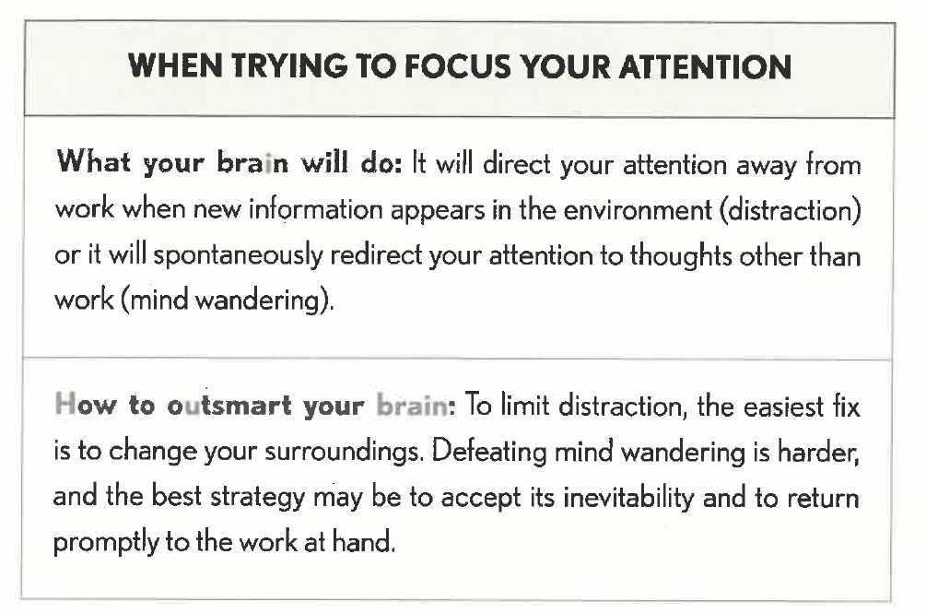

Slide 6
TAKING & ORGANISING NOTES
Evaluate your notes as you take them, to see if they will make sense to you later.
I don't recommend that you use a note-taking system, because I don't think they are worth the cost to attention. Using a special format for notes is just one more thing for you to think about when your mental state is in near overload most of the time.
During an experiment, people who saw an organised version of words (that had been put into a framework of different themes) remembered 65 percent of the words. Those seeing the unorgaised version remembered just 18 percent. Organisation creates links among the bits and pieces of what you're trying to remember.
The act of copying your notes does nothing to improve your understanding or memory. Pretty fonts and borders won’t do any harm, but they won’t help your comprehension or memory either.

Slide 7
REORGANISING NOTES: MOTIVATION
If reorganizing your notes after class is such a good idea, how come no one does it? In part because evolution has left you with a bias about what is worthy of attention. The brain thinks you should attend to novel things. Familiar things are safe if they have not been a threat in the past, they are unlikely to pose a threat in the future. Thus, we see no need to pay attention to the familiar. We know what the familiar thing is, we know it won't do anything to us, and therefore your brain wants to move on. That's why you quickly grow impatient if you look over the notes that you took at a presentation earlier the same day. "Yes, yes," you think, "I know all this."
Your brain tells you to seek new information. But this is a case when learners would benefit from disregarding the brain's impulse to seek out what is novel.

Slide 8
REVIEWING AND REORGANISING NOTES
People often see reorganizing their notes as a waste of time; it seems like a prelude to the real work of studying. But reorganising your notes doesn't just make it easier to study; the process of reorganising notes is itself studying. Reorganizing forces you to manipulate information and think about meaning, and you remember what you think about.
After the lesson, draw a diagram that illustrates how the main ideas of the lecture related to one another.
Teachers should let their students know that their notes are probably incomplete and disorganised; they won't be motivated to improve them if they don't perceive the problem. Consider low-stakes, open- notes quizzes for this purpose.

Slide 9
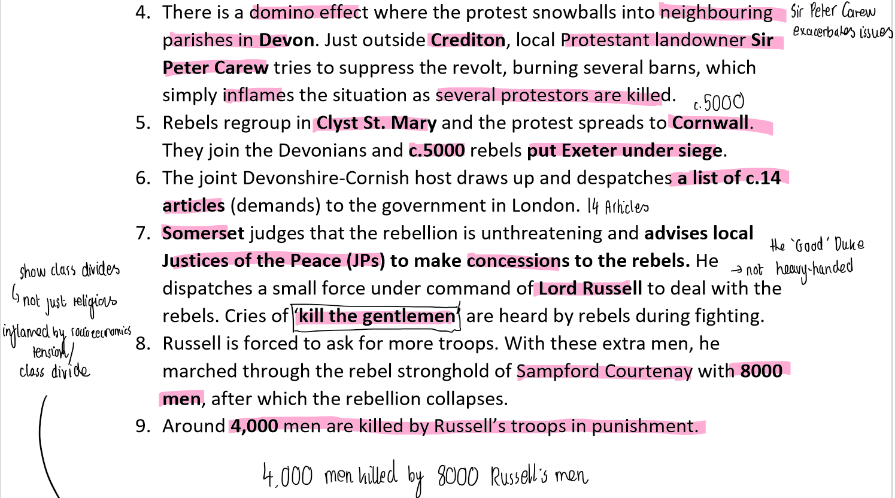

Slide 10
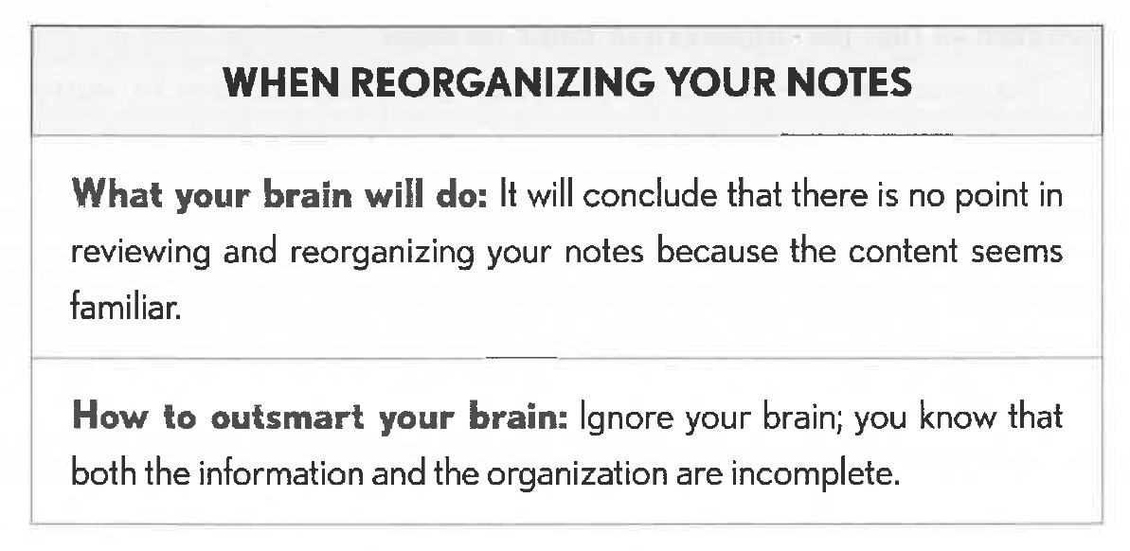

Slide 11
TAKING TESTS
Teach students to: Read. Each question. Carefully. My students sometimes get questions wrong because they read half of a question and assume they know what it's asking. Or they read the whole thing but somehow do not see the word not. When you think you have the answer to a question, take an extra few seconds to be sure the question asked what you thought it did.
Location can enter into a memory when you don't want it to. Researchers tested this idea with a simple experiment. There was some link between memory and location. Changing locations doesn't have a huge effect on memory, but students can try visualising the place where they studied the material they need to remember.

Slide 12
TAKING TESTS
Memories tend to be organised in themes/chunks. E.g. see how many animals you can name in sixty seconds. Suppose I gave you a hint, such as "Animals you see on a farm." Can you name any new ones? How about "Animals you'd see in Australia"? Memories can be retrieved in the themes they were encoded in.
If you're having a hard time figuring out which part of what you've learned is relevant to a question, list the topics you've learned on a scrap of paper or the test margin. This will serve the same purpose as my hints: Australian animals, farm animals, and so on. Once you've listed as many topics as you can, go through them one by one to see if they jog any memories to help you interpret and answer the question.
If you can't remember a fact, come back to the question in five or ten minutes.

Slide 13


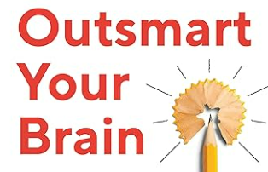

Organise your notes into themes to help you encode and later retrieve information
Stop distractions by changing your environment
Ignore your brain that tells you to seek out the ‘new’ or the novel and take time to review, reorganise and complete your notes

