Slide 1
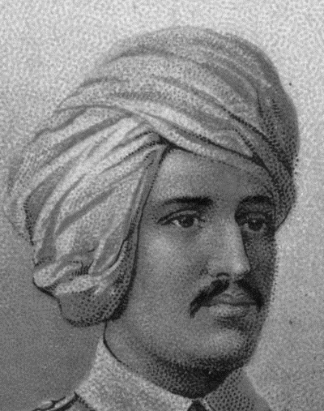
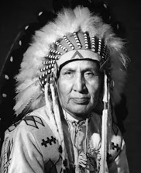

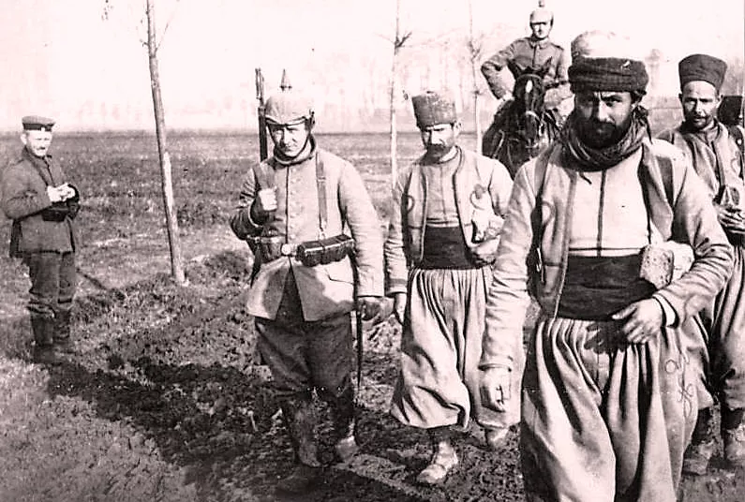
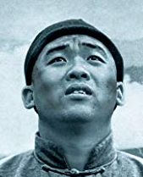
What links these men together?

Slide 2
Mike Mountain Horse
Ganga
Singh
Algerian Troops
Chinese labourers

Slide 3
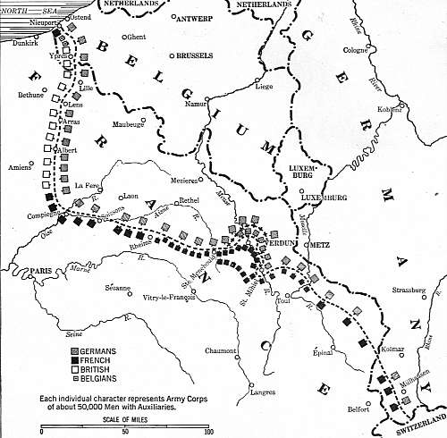
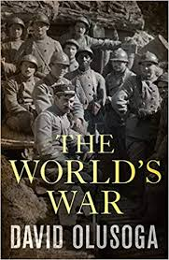
What do the stories of the ‘often forgotten armies’ reveal about the Western front?

Slide 4
The stories of the ‘often forgotten armies’ on the Western front
1914 | October: First Battle of Ypres
1915 | April: Second Battle of Ypres
1916 | July: Battle of the Somme
1917 | November: Battle of Cambrai

Slide 5
What does the story of Ganga Singh reveal
about the Western Front?
Weapons and new technology Given new and unknown weapons (e.g. rifle) and not trained to use them; dynamite in a jam jar: problems with equipment | Military Strategy Indian troops being used to plug gaps in British lines
Treatment of troops and life on the front line Expected to fend for himself; not issued a uniform that’s fit for purpose; almost seen as expendable? | The psychological effects of war Feeling of alienation, lack of safety – he can’t understand his officers! Disorientation: Paris or Persia?!

Slide 6
What does the story of African troops
reveal about the Western Front?
Weapons and new technology First use of chlorine gas by the Germans in 1915 | Military Strategy Germans able to open up a gap in the trenches, a small breakthrough in the stalemate
Treatment of troops and life on the front line Use of dugouts as protection No gas masks yet (1915) | The psychological effects of war Unable to communicate what had happened – ‘scared’ and ‘suffering’ (source)

Slide 7
What does the story of Mike Mountain Horse reveal about the Western Front?
Weapons and new technology Use of tanks | Military Strategy Cambrai was the first mass tank attack
Treatment of troops and life on the front line Religions / beliefs of colonial armies not always respected or ignored | The psychological effects of war Loss / devastation of war on families, near and far from the theatre of war

Slide 8
What does the story of Chinese Labourers reveal about the Western Front?
Weapons and new technology So much work that goes unnoticed – mechanics, cleaning | Military Strategy Preparation just as important as fighting – e.g. 110 tank-towed sledges to move equipment to battle
Treatment of troops and life on the front line Chinese labourers were segregated British were ‘surprised’ at the capability of the Chinese and didn’t want them at first: racial prejudices | The psychological effects of war Disinfected and heads shaved Segregation and alienation

Slide 9

What do the stories of the ‘often forgotten armies’ reveal about the Western Front?
What is the most important ‘smaller story’ revealed by the stories of the forgotten armies?
The troops’ stories help open up other stories of…

Slide 10

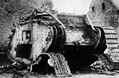
What might different historians look for when studying the ‘often forgotten armies’?
David Olusoga
Military historian

Slide 11
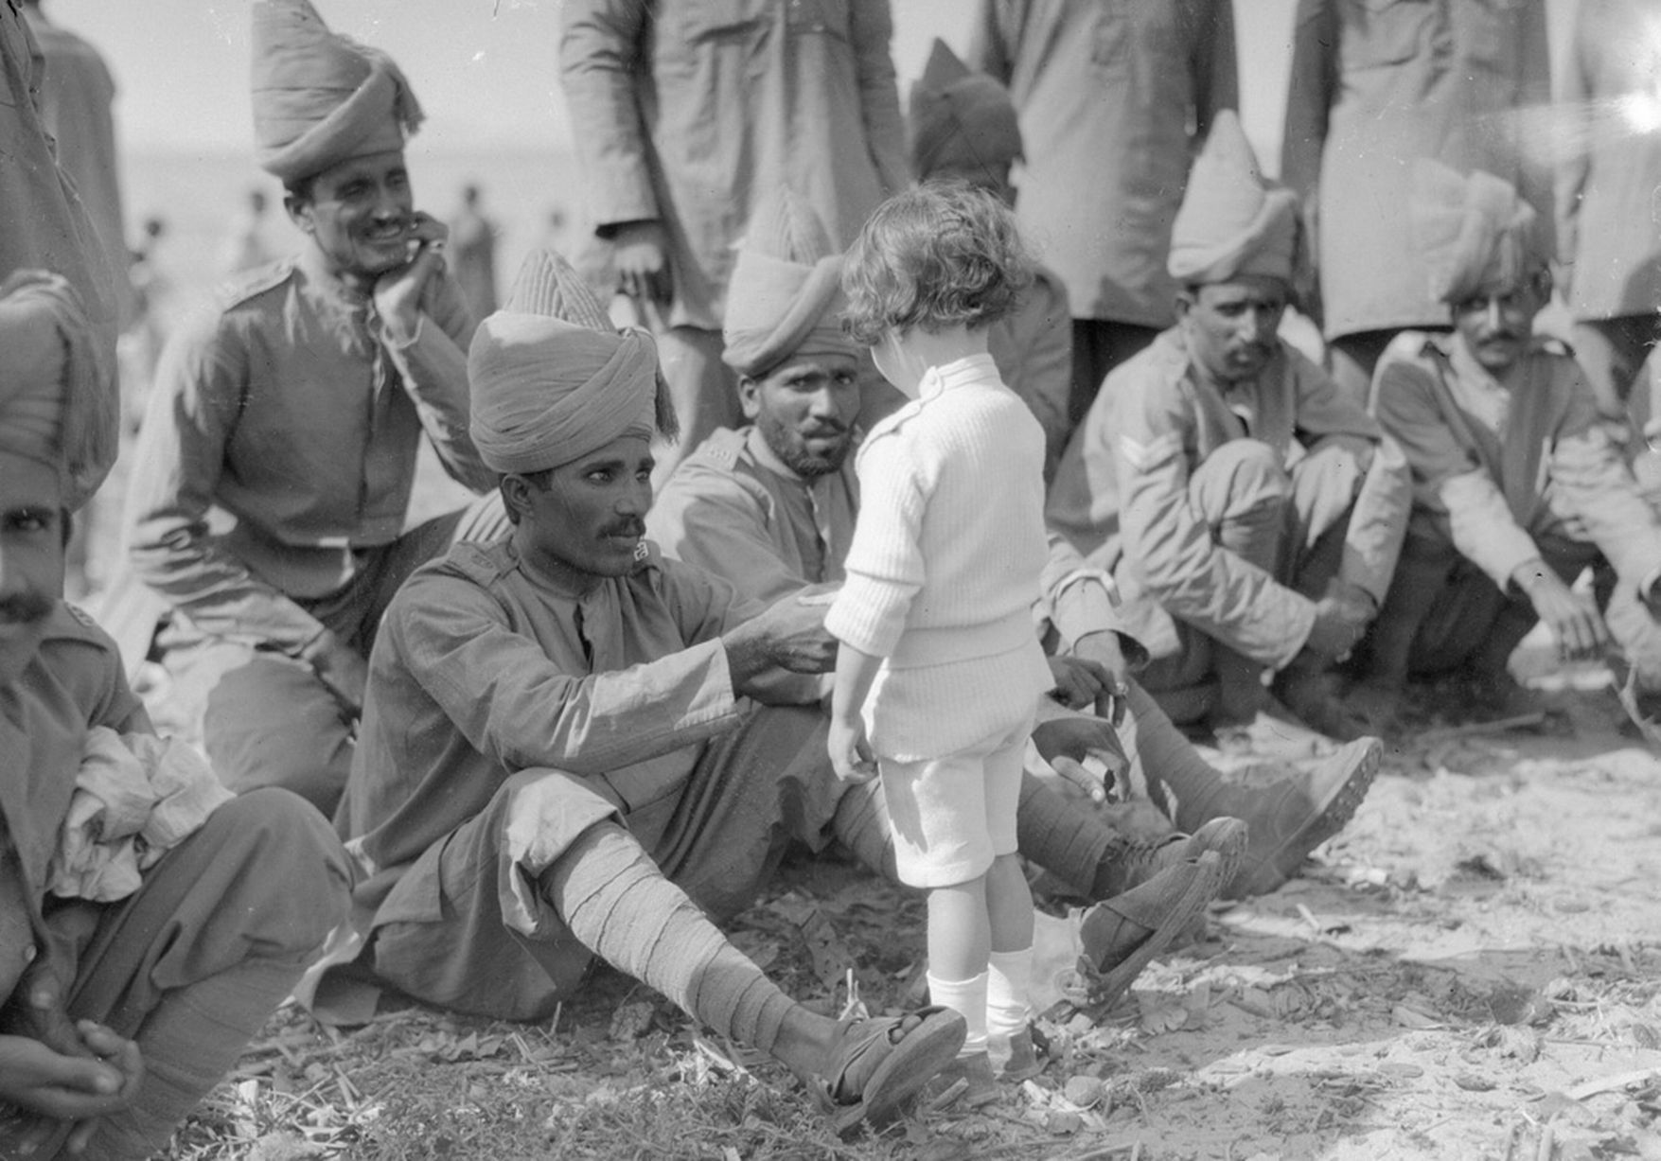

Slide 12
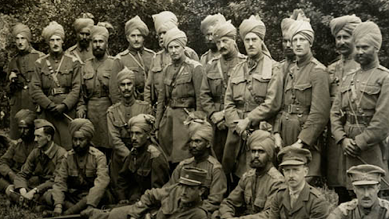

Slide 13
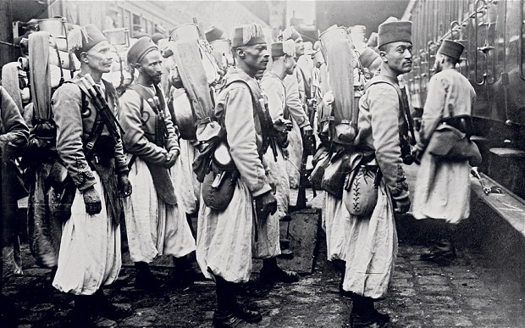

Slide 14
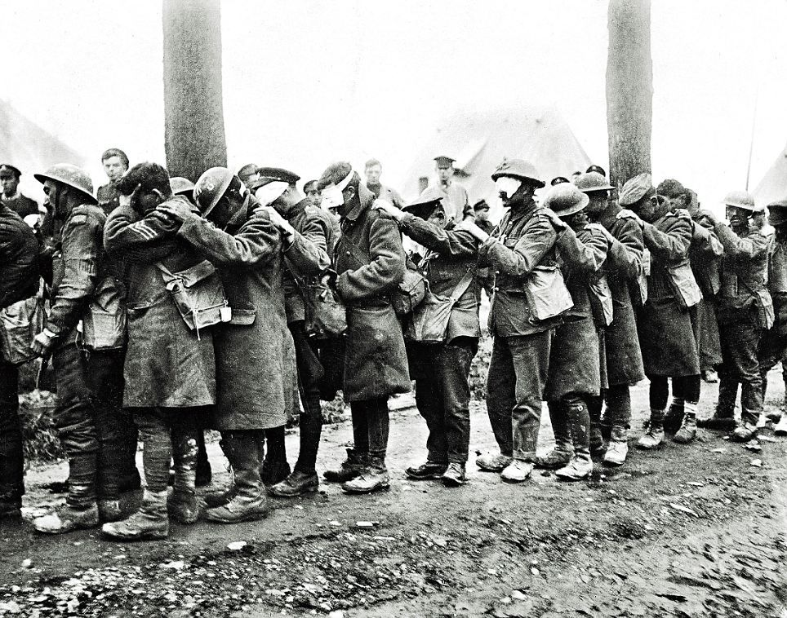

Slide 15
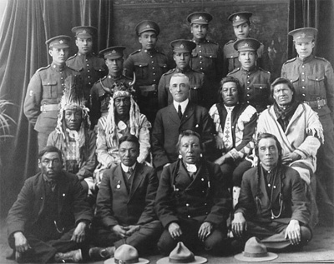

Slide 16
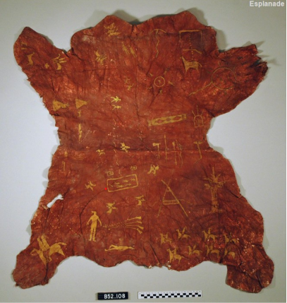

Slide 17
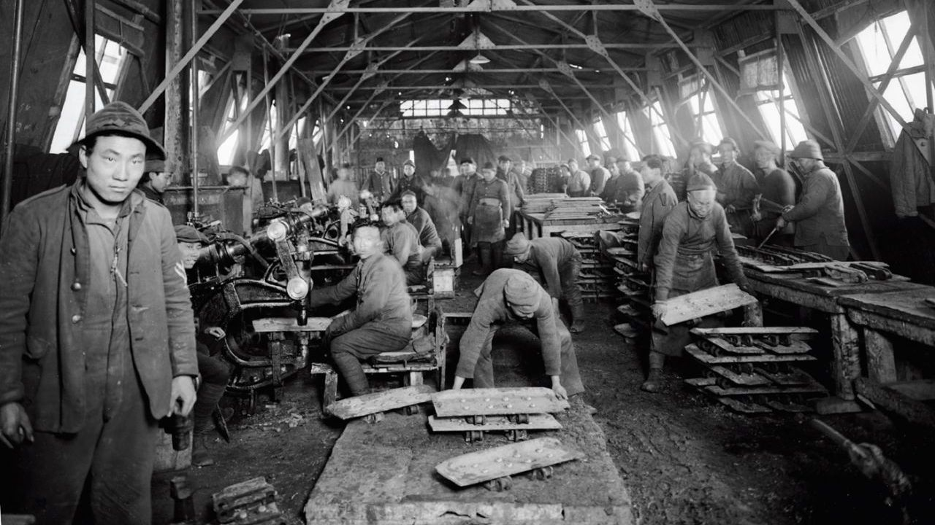

Slide 18
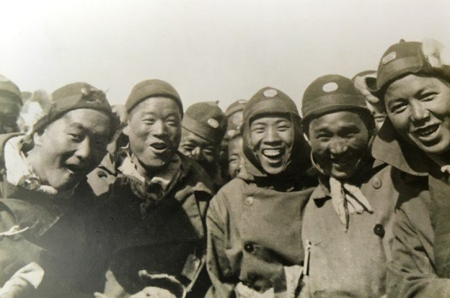

Slide 19
