Slide 1
How important was the use of aircraft to Allied victory in World War I?
Origins of the RAF video
Origins of the RAF: Activities
Who defeated the Luftwaffe in the Battle of Britain?
Battle of Britain video
Battle of Britain: Activities
What type of impact did codebreaking have in World War II?
6.09: Codebreakers video
Codebreakers: Activities
And… the Interactive Map

Slide 2
STARTER: Draw a World War I Pilot
What does he look like?
What sort of background does he have?
What does his job involve?

Slide 3

Public school
Arrogant
‘20 minutes’
https://www.youtube.com/watch?v=QC3sURgYxng
Lord Flashheart in Blackadder: From 30 seconds in

Slide 4
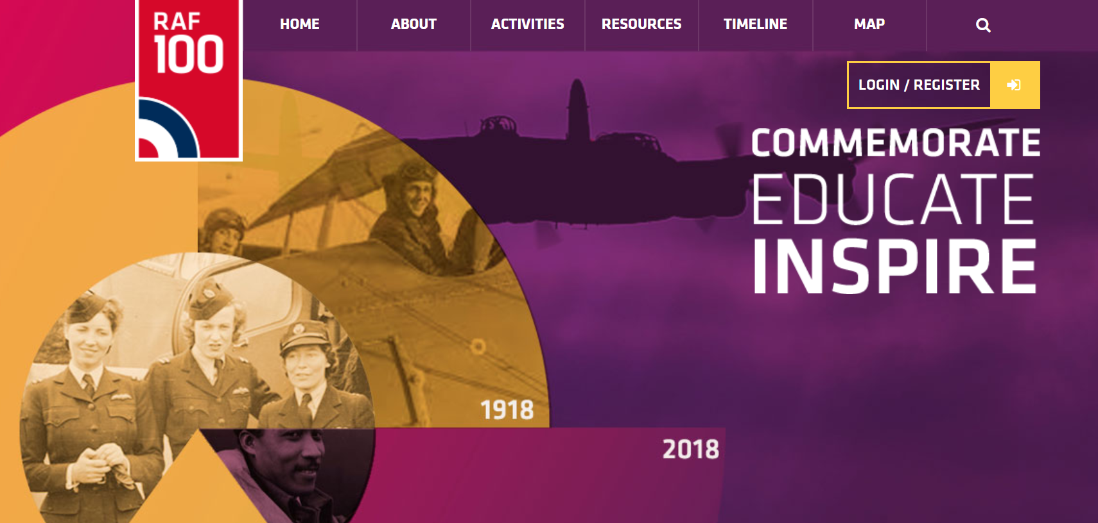
EQ: How important was the use of aircraft to Allied victory in World War I?
1. Origins of the RAF and Aircraft Design

Slide 5
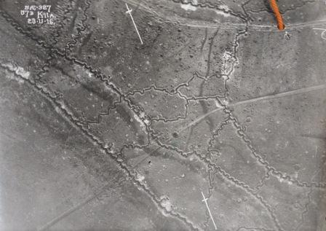
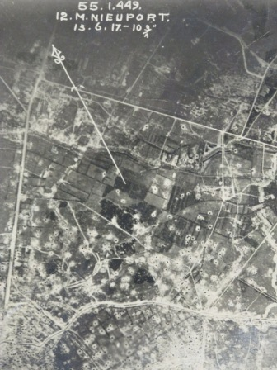
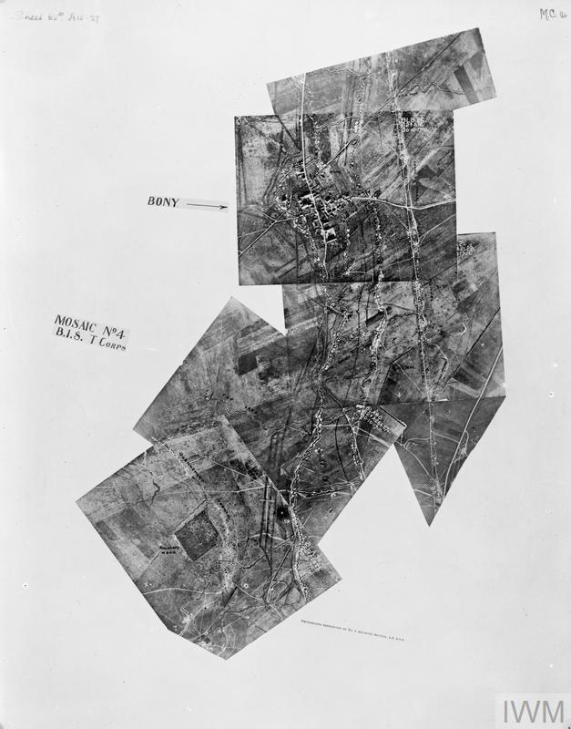
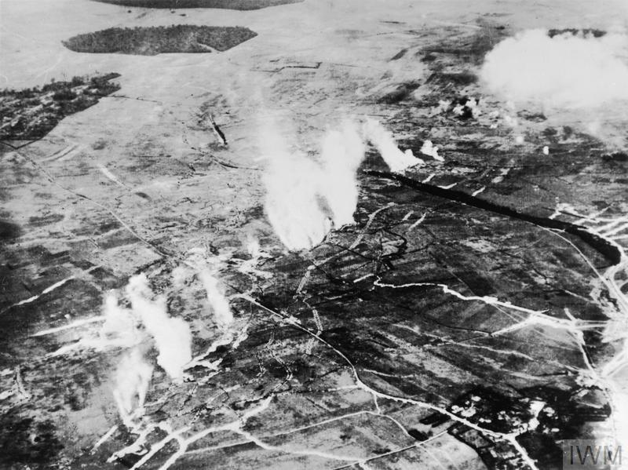

Slide 6
German trenches
network

Slide 7
Shelling

Slide 8
A mosaic of photographs showing a line of trenches

Slide 9
Gas attack

Slide 10
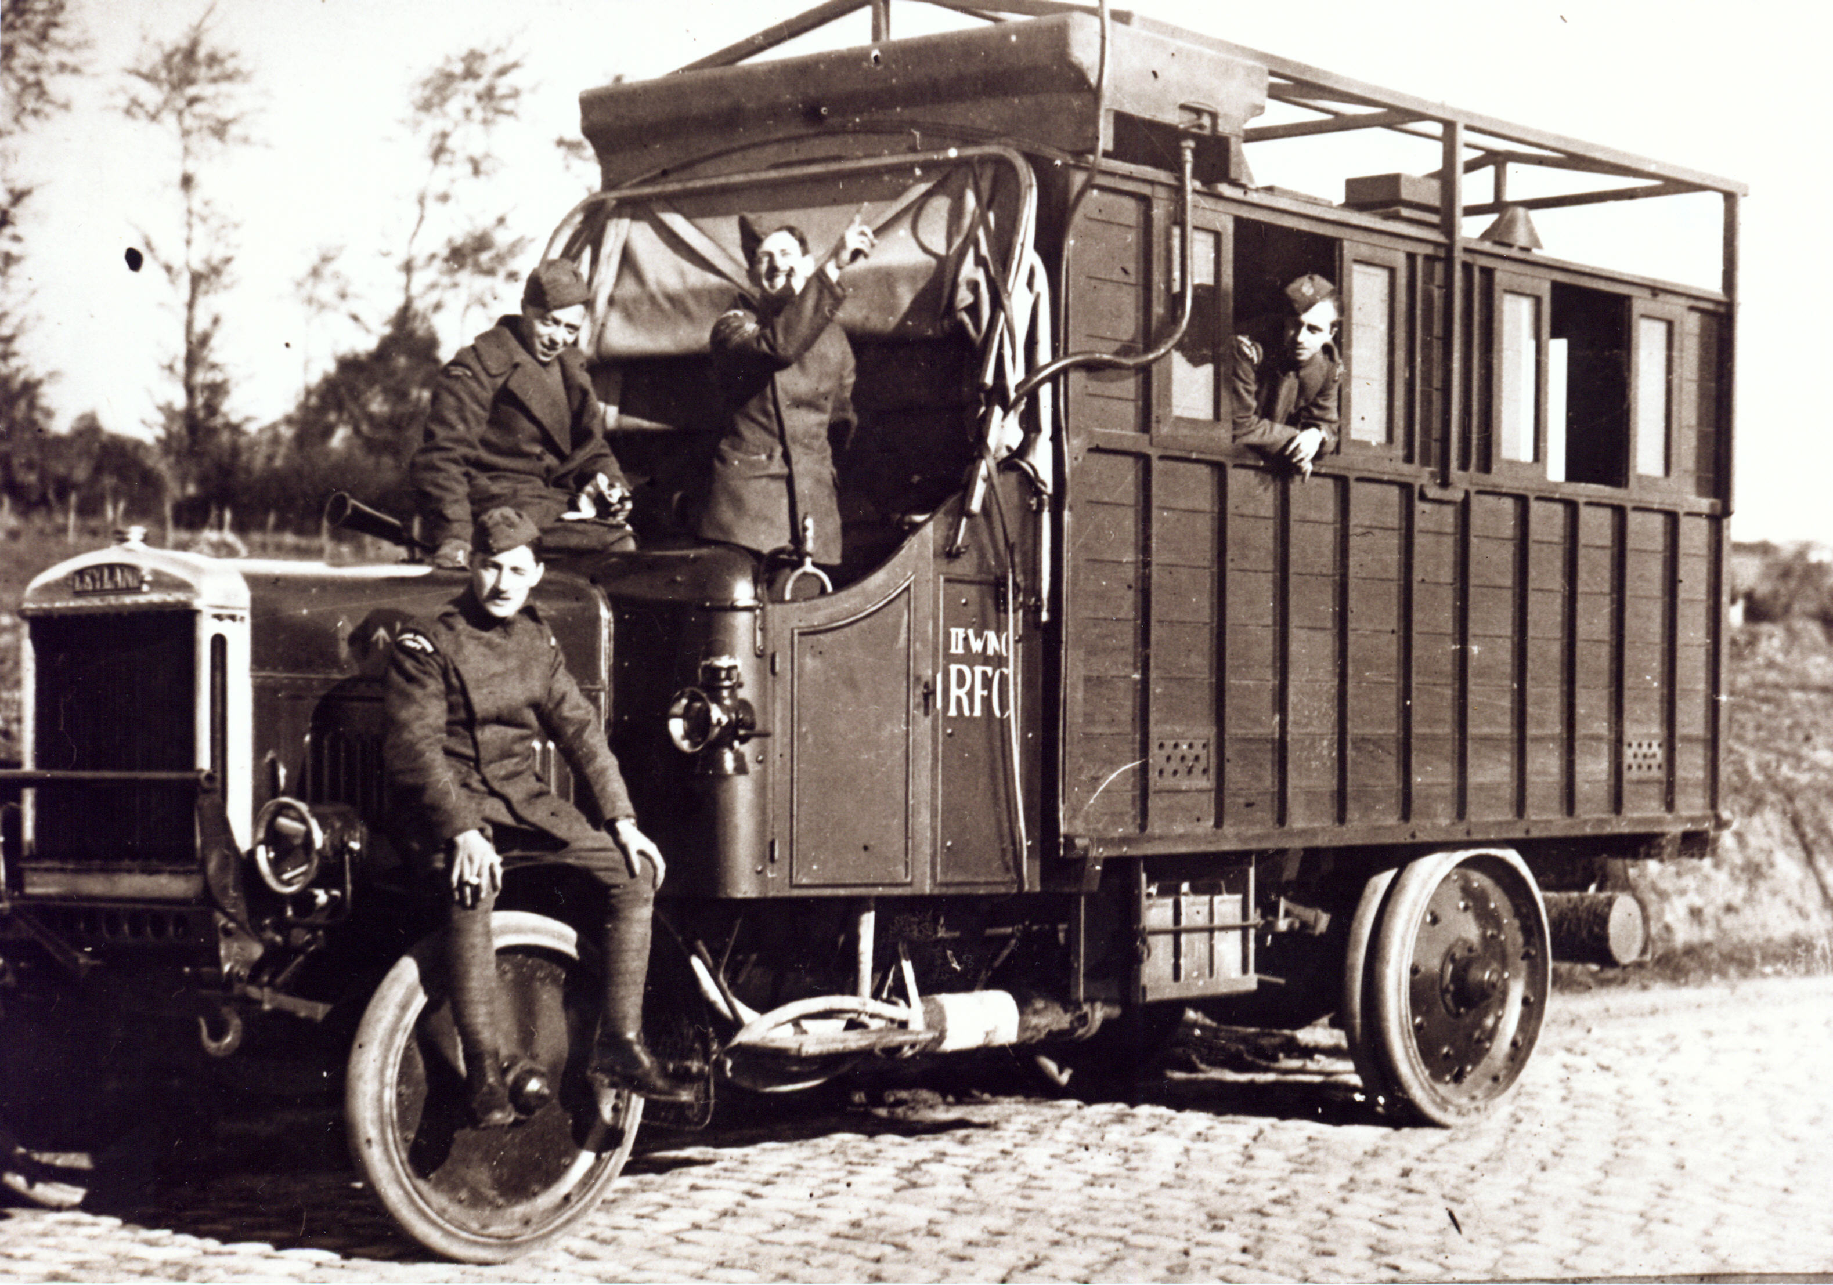
Photo processing vehicle, 1916

Slide 11
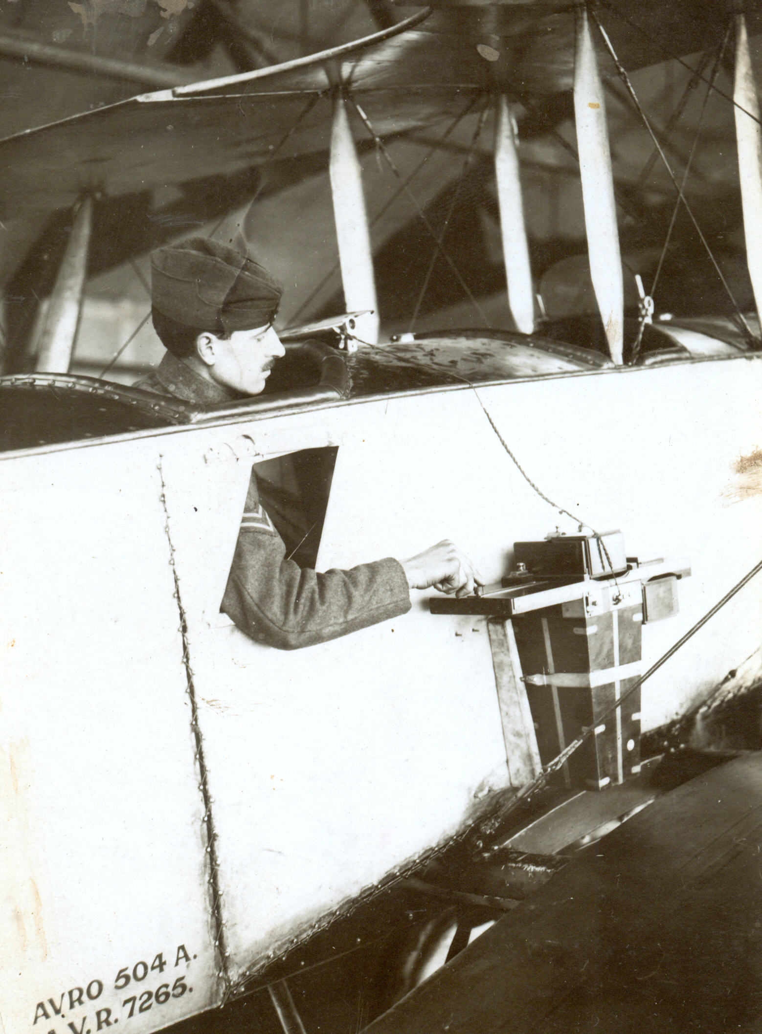
Camera

Slide 12
EQ: How important was the use of aircraft to Allied victory in World War I?
At the start of the First World War in 1914, people had only been successfully flying aeroplanes for ten years. Aircraft were basic machines, made of wood, canvas and wires, which were not able to travel very far or very fast. The aeroplanes were biplanes, as the technology of that time had not developed materials that could be strong enough but also light enough to withstand the mechanics of flight.
Most of the planes could only carry the pilot although, as time went on, they were able to carry two people. The Sopwith Camel was typical of the type of aircraft used in in the First World War made out of fabric-covered wooden surfaces. Its fuel tank was located at the rear of the aircraft, which made the position of its centre of mass vary significantly with changing fuel load, earning it a reputation for being difficult to fly.

Slide 13
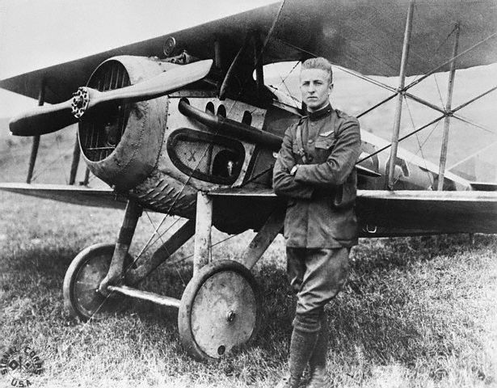

Slide 14
The origins of the RAF: World War I
EQ: How important was the use of aircraft to Allied victory in World War I?
The Sopwith Camel was a biplane – that is, it had two sets of wings. Early aircraft were built in this way due to the weakness of the materials of the time. Metal in production during that period was too heavy, especially for the low-powered engines available. By having two wings, the stress on a single wing was reduced; therefore, by sharing the load, the wings were less likely to snap. It would take more powerful engines and stronger materials before the more modern aircraft would be possible.
Despite the limitations of the early aircraft, they still provided a unique view of what was happening on the ground, and this led to the formation of the Royal Flying Corps (RFC) as part of the British Army in April 1912. The Royal Navy formed its own Air Service (RNAS) just before the war. Nonetheless, when the war started, Britain only had around 200 working aircraft as part of its military.

Slide 15
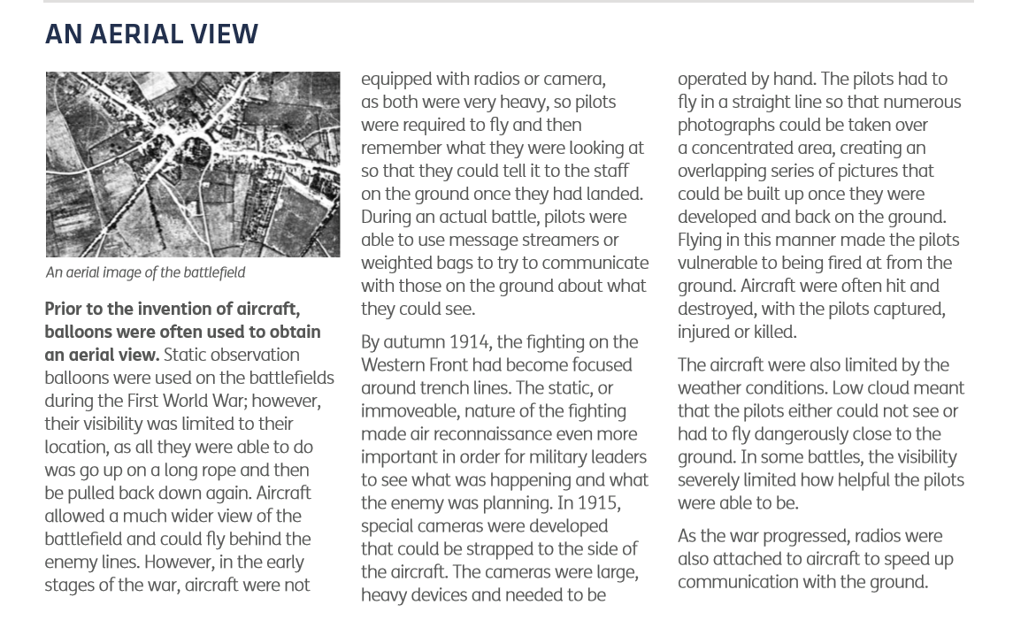
EQ: How important was the use of aircraft to Allied victory in World War I?
Complete the table outlining the three main roles of aircraft in World War I
Start with ‘An Aerial View’

Slide 16
Aircraft Role | Impact on the war | Problems/limitations | Importance (1-10)
Reconnai-ssance
Leaflet-dropping
Air defence of Britain

Slide 17
Aircraft Role | Impact on the war | Problems/limitations | Importance (1-10)
Reconnai-ssance | Offered a wider view of the battlefield than observation balloons and could fly behind enemy lines This helped to gather valuable intelligence about the enemy’s position | Materials were not very strong; few were built (c.200). Early planes could not hold cameras so pilots would have to remember what they saw Pilots were vulnerable to being hit as they flew in straight lines over the battlefield

Slide 18
Aircraft Role | Impact on the war | Problems/limitations | Importance (1-10)
Leaflet Dropping | Designed to be a morale-boost - aircraft were used to drop leaflets of support over occupied Belgium, France and Italy Helped to weaken morale on the enemy side as part of ‘psychological warfare’ It pushed designers to find ways for aircraft to carry more, and for pilots to be able to drop cargo or other items while still flying | Inaccuracy ‘Psychological’ impact is difficult to quantify

Slide 19
Aircraft Role | Impact on the war | Problems/limitations | Importance (1-10)
Air defence of Britain | Helped to defend Britain from German airships and later their bomber planes Helped to protect civilians air defences had to be prioritised and reorganised; this was one of the factors leading to agreement that there should only be one air service.

Slide 20
Listen to the report on the pilots and ground crew of World War I.
EQ: How important was the use of aircraft to Allied victory in World War I?
Add other people to your picture to sit alongside the pilot you drew at the start of the lesson.

Slide 21

‘Too simple!’*: aircraft and World War I
Aeroplanes were used for reconnaissance
Aeroplanes could fly over the Western Front into enemy territory
Pilots were young men from wealthy backgrounds
Pilots were very important in winning the war
*C. Counsell in Teaching History, 135, June 2009

Slide 22
EQ: How important was the use of aircraft to Allied victory in World War I?
Arrival of the Americans
Aircraft
Russian Revolution
Tanks
Convoy system

Slide 23
EQ: How important was the use of aircraft to Allied victory in World War I?
Aircraft
Arrival of the Americans
Tanks
Russian Revolution
Convoy system
Let your decision about the ROLE of the cause help you to think about how SIGNIFICANT it is in your explanation
triggered escalated fundamental the root cause
contributed exacerbated (made worse) initiated
set the ball rolling underlying pivotal sparked climax
prompted released central driven
pushed motivated provoked aggravated drew in
latent pulled fuelled masked supported

Slide 24
EQ: How important was the use of aircraft to Allied victory in World War I?
Aircraft
Arrival of the Americans
Tanks
Russian Revolution
Convoy system
Let your decision about the ROLE of the cause help you to think about how SIGNIFICANT it is in your explanation
triggered escalated fundamental the root cause
contributed exacerbated (made worse) initiated
set the ball rolling underlying pivotal sparked climax
prompted released central driven
pushed motivated provoked aggravated drew in
latent pulled fuelled masked supported

Slide 25
Aircraft Role | Impact on the war | Problems/limitations | Importance (1-10)
Reconnai-ssance | Offered a wider view of the battlefield than observation balloons and could fly behind enemy lines This helped to gather valuable intelligence about the enemy’s position | Materials were not very strong; few were built (c.200). Early planes could not hold cameras so pilots would have to remember what they saw Pilots were vulnerable to being hit as they flew in straight lines over the battlefield
Leaflet-dropping | Designed to be a morale-boost - aircraft were used to drop leaflets of support over occupied Belgium, France and Italy Helped to weaken morale on the enemy side as part of ‘psychological warfare’ It pushed designers to find ways for aircraft to carry more, and for pilots to be able to drop cargo or other items while still flying | Inaccuracy ‘Psychological’ impact is difficult to quantify
Air defence of Britain | Helped to defend Britain from German airships and later their bomber planes Helped to protect civilians air defences had to be prioritised and reorganised; this was one of the factors leading to agreement that there should only be one air service.

Slide 27
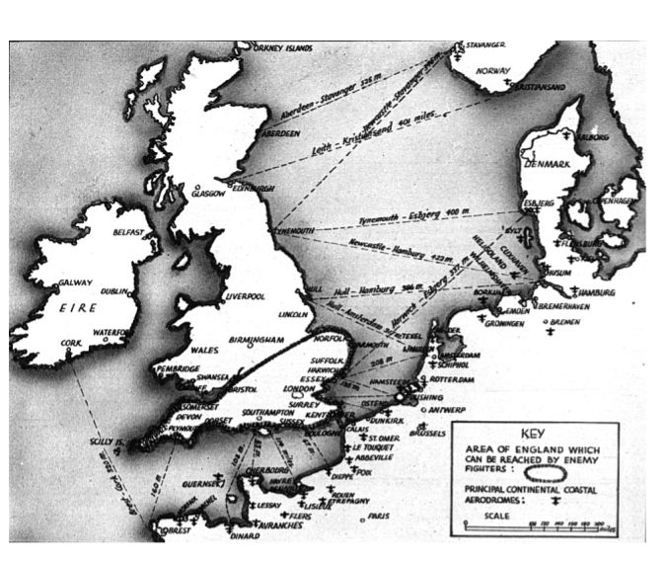
Who is planning what here?
Destruction of the RAF (by the German Luftwaffe), which was necessary for Hitler’s “Operation Sealion”.
Defence against invasion of Britain.

Slide 28
EQ: Who defeated the Luftwaffe in the Battle of Britain?
2. The Battle of Britain and Radar

Slide 29
EQ: Who defeated the Luftwaffe in the Battle of Britain?
The Battle of Britain was one of the most important Allied victories of the Second World War. The German air force (Luftwaffe) had been at the front of every attack the Nazis had made on their neighbouring countries, starting with the military attack on Poland in September 1939. The Luftwaffe would attack all the key defences of a country, including the airfields, clearing the way for the ground troops (the army) to invade.
The idea was that the country being attacked would not be able to stop the invasion, as its air force would have been destroyed and its military bases damaged. The battle plan had been successful for the Nazis when they attacked Poland, but was also very effective when they attacked Luxemburg, Belgium, the Netherlands and France in May to June 1940. It took the Germans just six weeks to take the four countries.

Slide 30
EQ: Who defeated the Luftwaffe in the Battle of Britain?
By late June 1940, it was obvious that the last country the Germans needed to defeat to achieve their conquest of Western Europe was Britain. For the Germans, it was essential that they destroyed Britain’s defences on its southern and eastern coasts before an attack was mounted across the English Channel. At the end of June 1940, German aircraft began flying across to Britain, carrying out reconnaissance and limited attacks. This was all in preparation for the main attack to begin…
Task: Put the narrative (story) of the Battle of Britain into the correct order

Slide 31
The German Luftwaffe attacked sites along the British coast and ships in the English Channel by dropping bombs. The Germans began preparations for Operation Sea lion: the planned invasion on Britain. A central part of the plan needed there to be no air defences or aircraft capable of attacking the German troops as they approached from the sea and on reaching Britain. | Having made their plan, the Germans focused the bombing raids on British airfields and radar stations. German bombers were accompanied by fighter planes. The main German air intensive assault was known to the Luftwaffe as Adlertag - Eagle Day. In harbours in occupied Europe, German ships were prepared for the sea attack. The Germans managed to destroy British aircraft and airfields but they did not stop the RAF from fighting back and no sea invasion could be launched.
Having had to postpone the invasion by sea, the Luftwaffe then began to bomb non-military and industrial sites and started to bomb towns and cities as well. The attacks went beyond the south east coast up into the south west, the Midlands, the North East of England and into Scotland. After attacks on British cities the RAF sent its first planes to bomb Berlin. | The Germans then decided to target even more cities with mass bombing raids – the Blitz had started. On the 15 September one of the heaviest bombing raids was launched against London. However, the RAF Fighter Command continued to attack the Luftwaffe and the Germans suffered huge losses. The day became known as ‘Battle of Britain’ day and forced Hitler to postpone his invasion.

Slide 32
Hitler felt forced to suspend his invasion because although the Luftwaffe had damaged airfields and factories, they had not damaged enough to stop Bomber command responding or aircraft being built. The radar stations had suffered little damage, which meant the early warning system was not stopped for any length of time during the battle. Instead, night raids on British cities were increased to try and exhaust the British public and to reduce German casualties. | By the end of October the Battle of Britain was over. The British air force was the first one to defeat the Nazis. The Blitz would continue for years as would aerial attacks, but the Germans would never mount a full scale attack on Britain again.

Slide 33
EQ: Who defeated the Luftwaffe in the Battle of Britain?
Radar Technology
During the 1920s and 1930s, scientists worked on ways of detecting aircraft from far away, long before they could be seen by people on the ground. The First World War – or Great War as it was then known – had used aircraft for light bombing raids and, with the advancements that had been made to aircraft, it was felt that a serious air attack was a real possibility in the future.
The Air Ministry set up the Committee for the Scientific Survey of Air Defence in 1934, and scientists including Robert Watson Watt, Arnold F Wilkins and Edward George Bowen tried out ways to create a detection system for incoming aircraft. One of the favoured methods was using radio waves and, on 17 June 1935, radio waves as a way of spotting aircraft was first successfully demonstrated by the British scientists.

Slide 34
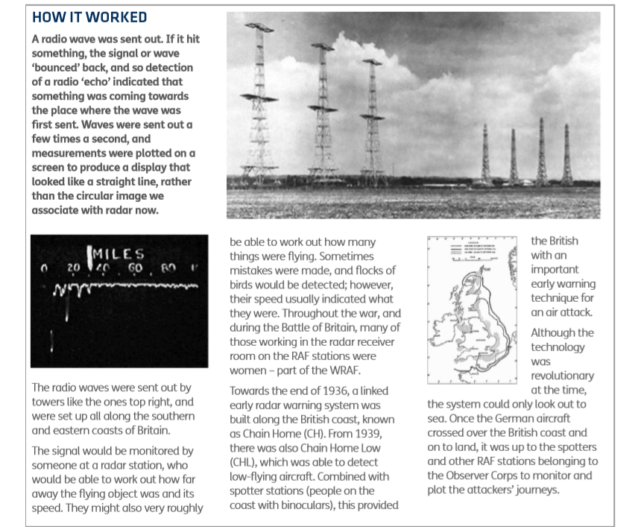

Slide 35
EQ: Who defeated the Luftwaffe in the Battle of Britain?
From Radar to Scramble!
Air Chief Marshal Sir Hugh Dowding, Commander-in-Chief of RAF Fighter Command, created a reporting and responding system that ensured that the radar early warning system was as effective as possible.
The Dowding system divided the UK into groups and sectors, organising a reporting structure for all the information collected that could be acted on with sufficient speed, so that any attack could be met with a British fighter response.
All information collected at the radar stations was checked and then sent through to the headquarters of Fighter Command at Bentley Priory (near Harrow, North London), where Dowding had his own HQ.

Slide 36
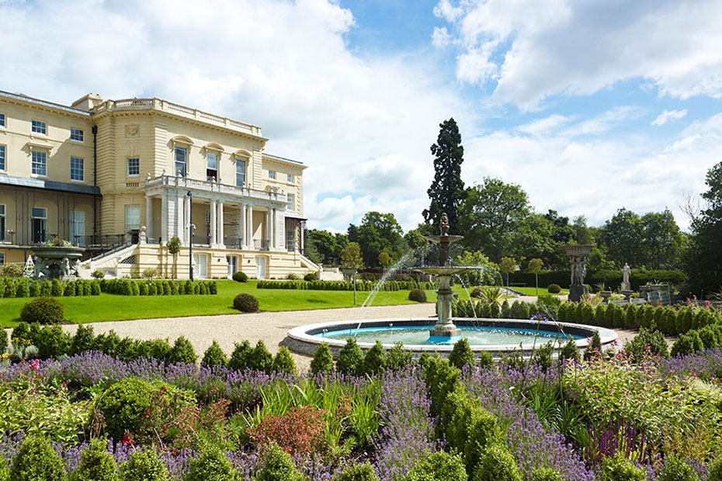
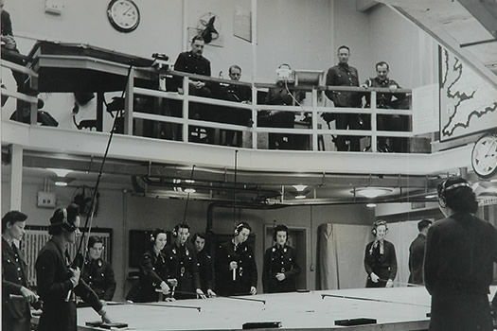
Fighter Command HQ at Bentley Priory

Slide 37
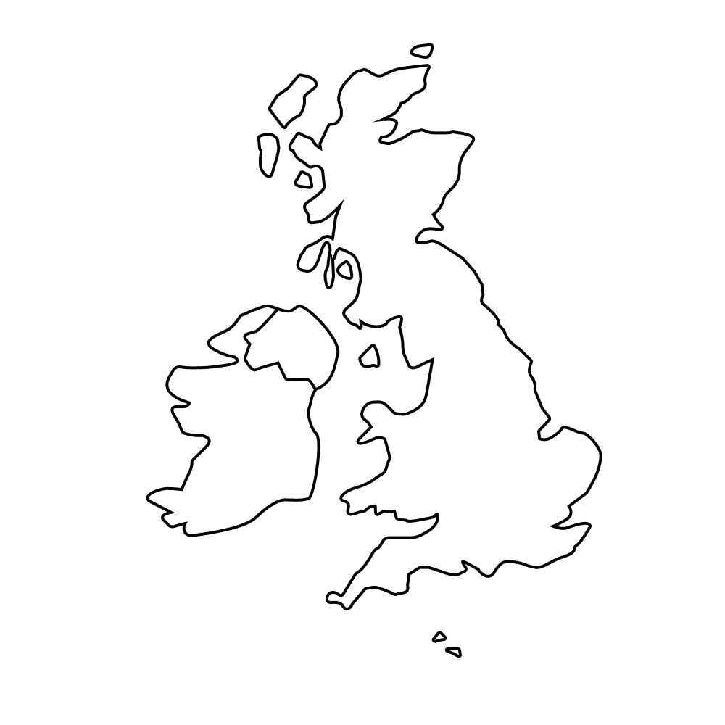
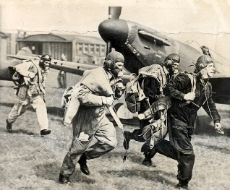
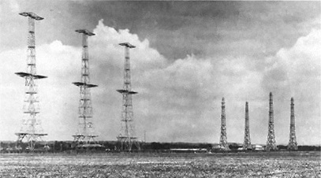
The
Radar stations
Scramble!
The Dowding system
Task: Use the information to copy the four sections of the ‘Dowding system’ onto your map of the UK
(fourth page of your PDF)

Slide 38
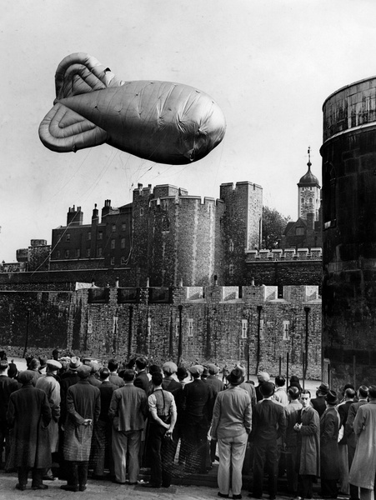
Barrage Balloons
EQ: Who defeated the Luftwaffe in the Battle of Britain?
These were used to defend against aircraft attack by raising aloft cables which pose a collision risk, making the attacker's approach more difficult. The balloons force aircraft to fly higher and into the range of concentrated anti-aircraft fire.
By the middle of 1940 there were 1,400 balloons, a third of them over the London area.

Slide 39
p.4-5
EQ: Who defeated the Luftwaffe in the Battle of Britain?
Create a chart showing the communication process that began with radar detection of enemy aircraft and finished with ‘scramble’. Use arrows and symbols. Include the approximate number of minutes for the different parts of the process and the following places and people:
  Fighter Command HQ at Bentley Priory
  Telephonists
  Group HQ Operations Rooms
  Duty Commanding Officers
  Map plotters
  Airfields
  Anti-aircraft guns
  Barrage balloon crews

Slide 40
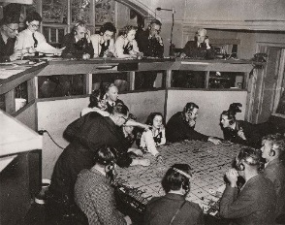

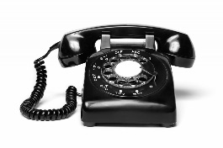
The
4 minutes
Group HQ Operations Rooms
Map Plotters
Radar
Stations
Commanding Officer
Air-
fields
Scramble!
14-16 minutes
Anti-Aircraft guns
The Dowding system
Barrage balloons
Fighter Command HQ at Bentley Priory
What was the most important part of the process?
Was it the pilots, the telephonists, the commanding offers, the map plotters or the radar operators?

Slide 41
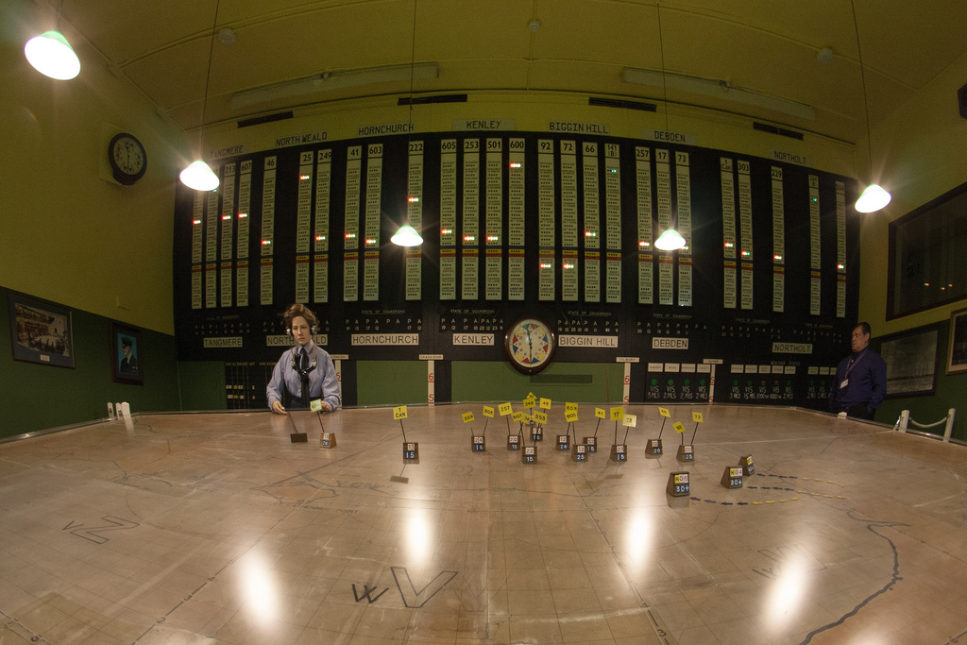
Uxbridge (London) RAF Bunker
Group 10’s HQ

Slide 42
Who defeated the Luftwaffe in the Battle of Britain?
The WRAF and the role of women
The Polish contribution
Air Transport Auxiliary
A range of jobs
p.6-7

Slide 43
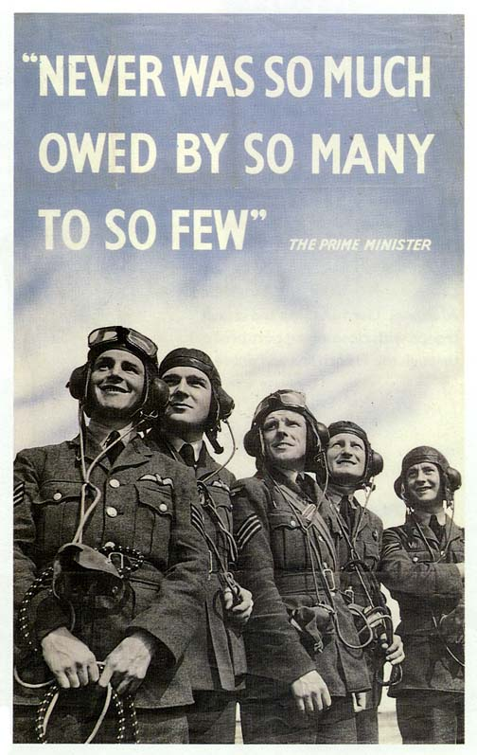
Who defeated the Luftwaffe in the Battle of Britain?
What is missing from this poster?

Slide 44
Starter: What could this be?
URYYB

Slide 45
What do you need to break the code?
How might it have been created?

Slide 46
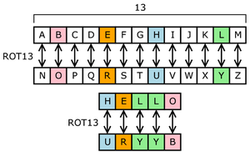
ROT13 is a Caesar cipher, a type of substitution cipher. In ROT13, the alphabet is rotated 13 steps.
What is the problem with this cipher?

Slide 47
What is the problem with a ‘Caesar cipher’?
There are only ________ distinct shift cipher possibilities, which makes them easy to break by simply trying each possibility in turn.
A better encryption method is to use a system in which any letter can be represented by any other, in no particular order. These substitution ciphers can be generated by using a keyphrase (or ‘crib’).
Notes:
25

Slide 48
What key phrase (‘crib’) has been used to create this cipher?
R | O | Y | A | L | I | F | C | E | B | D | G | H | J | K | M | N | P | Q | S | T | U | V | W | X | Z
A | B | C | D | E | F | G | H | I | J | K | L | M | N | O | P | Q | R | S | T | U | V | W | X | Y | Z
ROYAL AIR FORCE
If using ‘Royal Air Force’ as a keyphrase, begin by removing any spaces and repeated letters (ROYALIFCE) and then use this at the beginning of the alphabet. The remainder of the cipher alphabet is the remaining letters, in the correct order, starting where the keyphrase ends.

Slide 49
How might this code be broken without knowing the keyphrase?
R | O | Y | A | L | I | F | C | E | B | D | G | H | J | K | M | N | P | Q | S | T | U | V | W | X | Z
A | B | C | D | E | F | G | H | I | J | K | L | M | N | O | P | Q | R | S | T | U | V | W | X | Y | Z
If someone does not have the keyphrase then trying to work out the cipher can be extremely time consuming, as there are many billions of possibilities. How people set about breaking a cipher like this is to use frequency analysis.
All languages use some letters more than others; in English, for example, the letter _____ is the most common letter, followed by ____ and then _____. By comparing the frequency of letters that appear in the encrypted message to those in a long piece of plain text, most of the letters can be identified.
Notes:
ETA

Slide 50
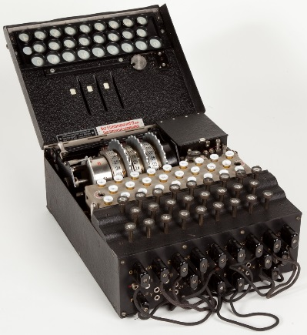
Break the code to discover what we will be learning about in today’s lesson
R | O | Y | A | L | I | F | C | E | B | D | G | H | J | K | M | N | P | Q | S | T | U | V | W | X | Z
A | B | C | D | E | F | G | H | I | J | K | L | M | N | O | P | Q | R | S | T | U | V | W | X | Y | Z
LJEFHR
ENIGMA.
Notes:
Enigma: a machine used by the Germans to send secret messages during the war

Slide 51
3. Codebreakers and Communication Technology

Slide 52
 | A method of keeping the meaning of a message hidden by changing whole words, and replacing them with other words or using a different symbol, such as images. At sea flags might be used to replace words and sentences
Encoded | Hiding a message by jumbling up individual letters of the message
Encryption | Sending a whole message with the letters jumbled up using a cipher
 | Knowing what the cipher is to unravel an encrypted message, e.g. knowing that each letter has been replaced by the one next to it in the alphabet
 | A method of hiding a message by mixing the letters up by simply moving each one along the alphabet, e.g. a = c, b=d, c=e, etc.
 | The way to find out how a substitution cipher has mixed up the letters; this term refers to the keyword that gives you the first few letters of the alphabet and then the rest can be worked out
 | Unravel an encrypted message
 | Someone who studies secret messages in order to gain access to encrypted information
 | Someone who has to read through all the information gathered from secret messages and from open sources to try to identify what is true and whether there are any patterns in the information, and who then has to recommend a course of action
Bombe machine | A machine invented to work out how to decrypt a message that was encrypted by an Enigma machine
 | A machine used by the German military in the Second World War to encrypt all their messages that were sent by radio or electric telegraph
Y Station | A place in the UK with a large aerial that listened into and wrote down the secret encrypted messages being sent by the Germans and their allies, and which then sent them to the UK intelligence sites for decryption

Slide 53
What type of impact did codebreaking have in World War II?
Decryption
Cryptanalyst
Secret Code
Caesar cipher
Intelligence analyst
Crib
Decipher
Enigma
Answers: P.1

Slide 54
What type of impact did codebreaking have in World War II?
For governments during a war, keeping their communication secret is highly important, and these messages may include information between friendly governments, messages to army leaders giving out orders for an attack, or requests for more supplies. Trying to capture or intercept a message being sent in secret can reveal important information to another side. It could be something big, such as when a battle is planned, or it could be something that seems small, such as a shortage of bread – but it all reveals an important aspect of how a side is managing or planning.
Governments have established special organisations – intelligence agencies or ‘spies’ – to intercept messages, but if the message is encrypted, they then need people who can break the cipher. Once a cipher or code is broken, the meaning of the message can be revealed – however, the real significance of that message can only be fully understood if lots of bits of information are gathered together to create a full picture. This means that an intelligence group and a codebreaking group have to intercept, break and analyse hundreds of messages to make proper use of the information during a war.

Slide 55
What type of impact did codebreaking have in World War II?
In the field of secret communications (cryptography), a code refers to a way of keeping the meaning of a message hidden by changing whole words. For example, during the Second World War, the word ‘DYNAMO’ was used by the Allies when referring to the operation to rescue troops from Dunkirk beach.
In contrast, a cipher relies on hiding a message by jumbling up individual letters of the message. For example, the word ‘DUNKIRK’ can be hidden by replacing each letter with the next one in the alphabet, so that once it has been encrypted it will read ‘EVOLJSL’.
In both World Wars, all sides relied mostly on the use of ciphers rather than codes, as ciphers only required the sender and receiver to share a set of short instructions that could be changed easily, rather than a large codebook that included alternatives for all the words that they may need to keep secret.

Slide 56
What type of impact did codebreaking have in World War II?
In the First World War, or Great War, as well as more traditional methods, such as carrier pigeon, millions of messages were sent using the modern technology of radio broadcasts and electric telegraph.
Radio waves and electric circuits were used because messages could be sent over long distances in a matter of seconds, unlike someone sending a paper message. However, anyone could quite easily listen in to radio messages or intercept telegraph communications and understand what the message was. This is why governments started to encrypt their messages.
The encryption technique (cipher) had to be agreed in advance so that the person receiving the message could decipher it and understand what they were being sent.

Slide 57
What type of impact did codebreaking have in World War II?
In 1909, the British government created the Secret Intelligence Service (or Bureau as it was known for a while). The SIS was engaged in all areas of intelligence-gathering, codebreaking and analysis of information.
After the Great War, Hugh Sinclair, the Director of Naval Intelligence, created the Government Code and Cipher School. Sinclair also became the head of SIS. All these intelligence units were based in London. During the 1920s and 1930s, the staff at GC&CS grew, and they became aware that new methods of encrypting messages were emerging.
Recruitment of codebreakers had usually focused on linguists: those who were good at languages (especially as many intercepted messages, once decrypted, would still be written in a foreign language). However, technological changes in that period meant that messages that were being sent seemed to have far more complex ciphers than the ones people were used to – it was obvious that some type of machine was also involved to create a cipher. Sinclair decided to start recruiting mathematicians as well as linguists to his team.

Slide 58
What type of impact did codebreaking have in World War II?
In 1938, events across Europe made war look likely again. Sinclair decided that having all his important people in London might be dangerous, as London was likely to be attacked from the air in any war, just as it had been during the First World War. So the government secretly bought or took over (requisitioned) a number of country houses in the Home Counties around London.
One of the key purchases was Bletchley Park in the village of Bletchley, Buckinghamshire, just outside London. The site was ideal as it had plenty of space and was very close to a train station from which trains travelled straight into London. The whole of the code and cipher school was transferred to Bletchley in 1938 under the leadership of Alastair Denniston.
The challenge facing those working at Bletchley was how to break Enigma...
p.4
How Enigma works: http://www.bbc.co.uk/history/code_breaking/#p00chmy6

Slide 59
What type of impact did codebreaking have in World War II?
TURING-WELCHMAN BOMBE
MISINFORMATION/
DECEPTION
Code-breaking in World War II
Y-STATIONS
BLETCHLEY-PARK
CODE-BREAKERS
THE RAF
p.5-7

Slide 60
What type of impact did codebreaking have in World War II?
Hut 3 Headlines
‘Ultra’ intelligence reports, produced by Hut 3 at Bletchley Park, were sent daily to Prime Minister Winston Churchill and Allied commanders from May 1941 to May 1945.
Hut 3 Section focused on wireless messages intercepted from the German army and air force, deciphering and analysing the information they contained. Particularly important messages were summarised into these ‘Headlines’.
TASK: Match the message to the explanation

Slide 61
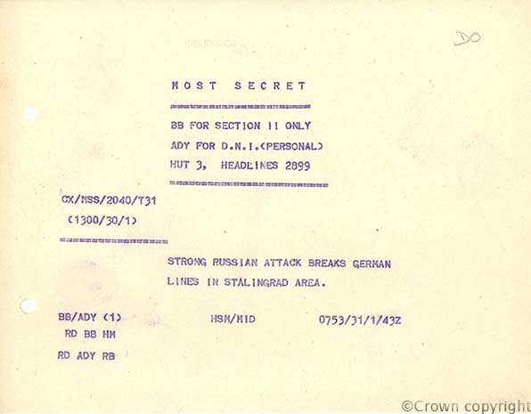

Slide 62
What type of impact did codebreaking have in World War II?
Field Marshal von Paulus, a lead commander of the German forces in Russia, is captured by this attack in 1943. Two days later Germany surrenders the city. This is a humiliating surrender for Germany, as the city is named after the Russian leader and the German advance was pushed back.

Slide 63
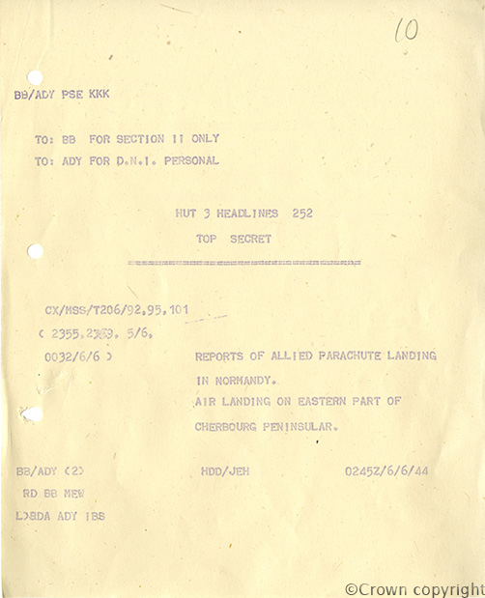

Slide 64
What type of impact did codebreaking have in World War II?
Germany notices the D-Day landings in northern France in June 1944 but little realises that they will lay the foundations of the Allied victory on the Western Front.

Slide 65
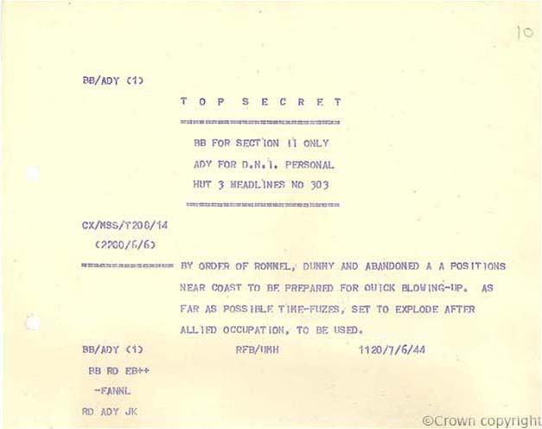

Slide 66
What type of impact did codebreaking have in World War II?
Field Marshal Rommel orders booby traps to be laid to impede the advancement of Allied forces into German-held territory in June 1944.

Slide 67
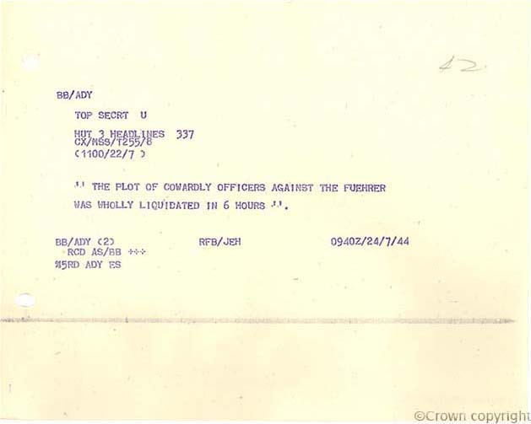

Slide 68
What type of impact did codebreaking have in World War II?
Operation Valkyrie, 24 July 1944: The 20 July Plot by senior German Army officers to assassinate Adolf Hitler in a bomb attack has failed.

Slide 69
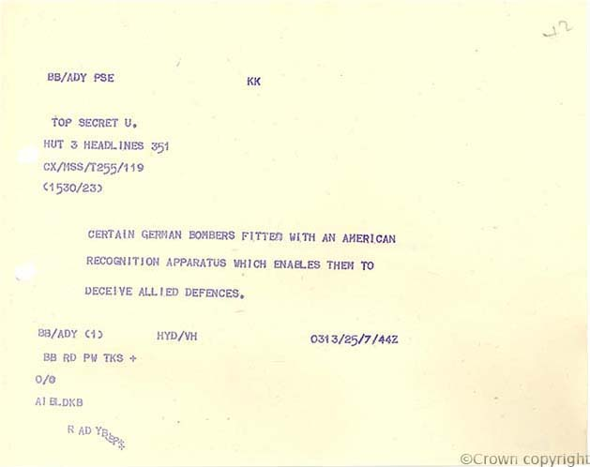

Slide 70
What type of impact did codebreaking have in World War II?
The air war, 25 July 1944. The Germans are using electronic devices to deceive the Allies’ aircraft recognition apparatus, disguising their aircraft as friendly.

Slide 71
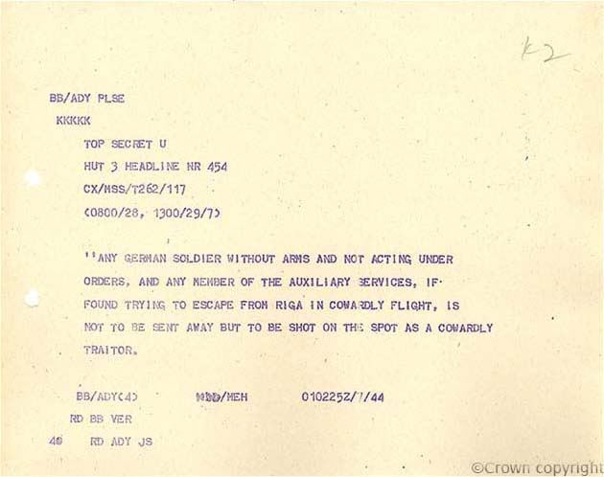

Slide 72
What type of impact did codebreaking have in World War II?
The Red army is advancing towards German-occupied Riga, the Latvian capital city, in late July 1944. The German army attempts to stimulate maximum engagement of its troops in an attempt to maintain control of the city.

Slide 73
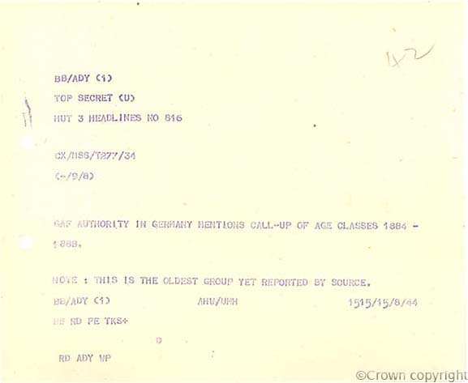

Slide 74
What type of impact did codebreaking have in World War II?
German Home Front, 15 August 1944. Germany is so desperately short of manpower that it begins to conscript men aged between 55 and 60.

Slide 75
What type of impact did codebreaking have in World War II?
Consequences for Britain and her allies
Consequences for Germany
Helpful Damaging Peaceful Centralising
Extreme Upsetting Beneficial Instructive
Mild Immediate Subtle Confusing
Far-Reaching Violent Multi-faceted Muddling
Undermining Strengthening Unifying Destabilising

Slide 76
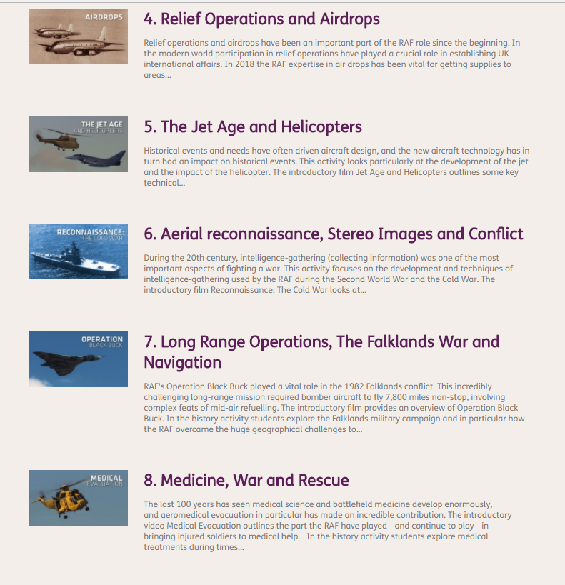
And on…

Slide 77
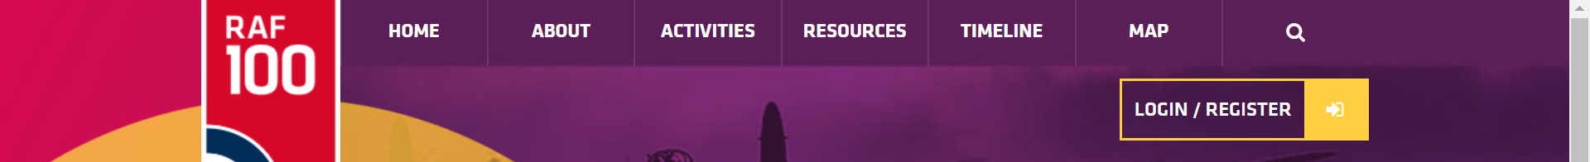

Electronic resources
www.raf100schools.org.uk/
www.lobworth.com

Slide 78
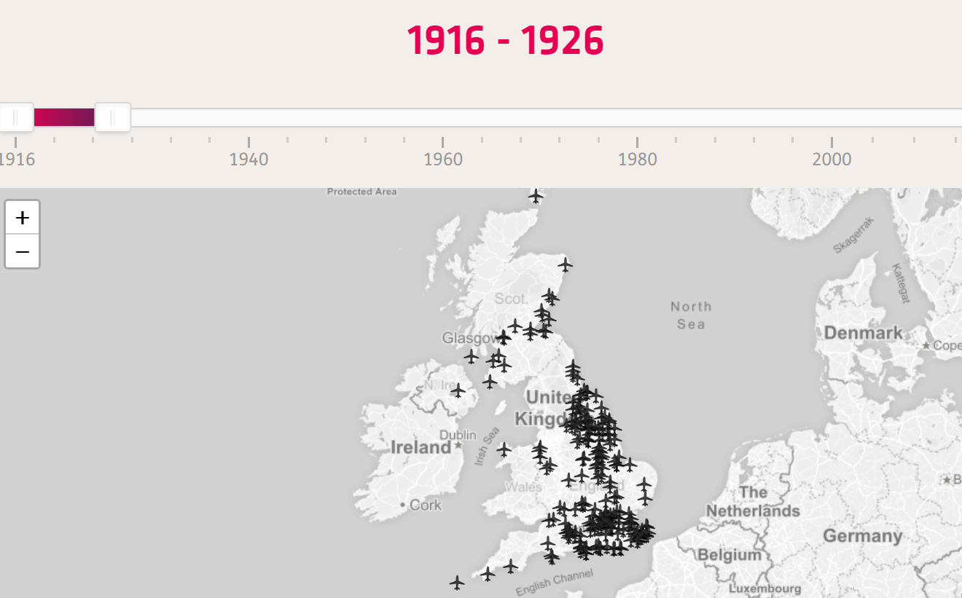
Interactive Map: Megan Dibble

