Slide 1
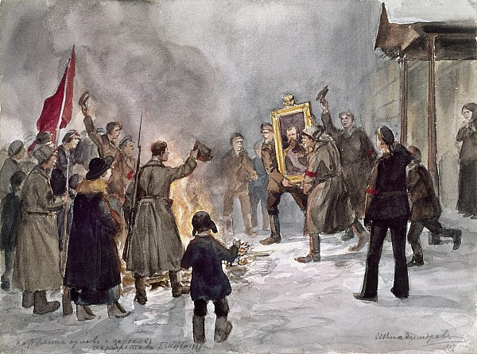

10
=
Paint by Numbers:
Causes of the February Revolution
Rasputin1
Size of Empire 2
World War I 3
Bolshevik Prop. 1
1905 Rev. 1
Rich vs Poor 2

