Slide 1
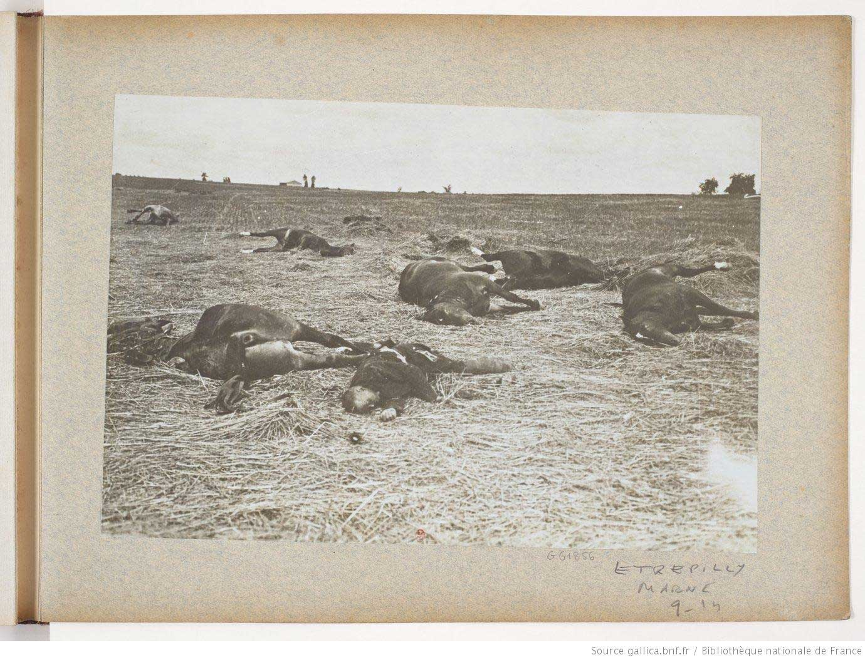
How do we know that this image has been taken during a battle at the start of the war? (1914)?
How does this image link to the failure of the Schlieffen Plan?

Slide 2
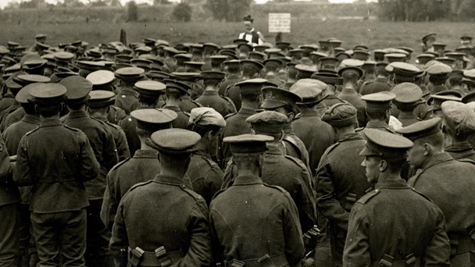
What is happening here?

Slide 3
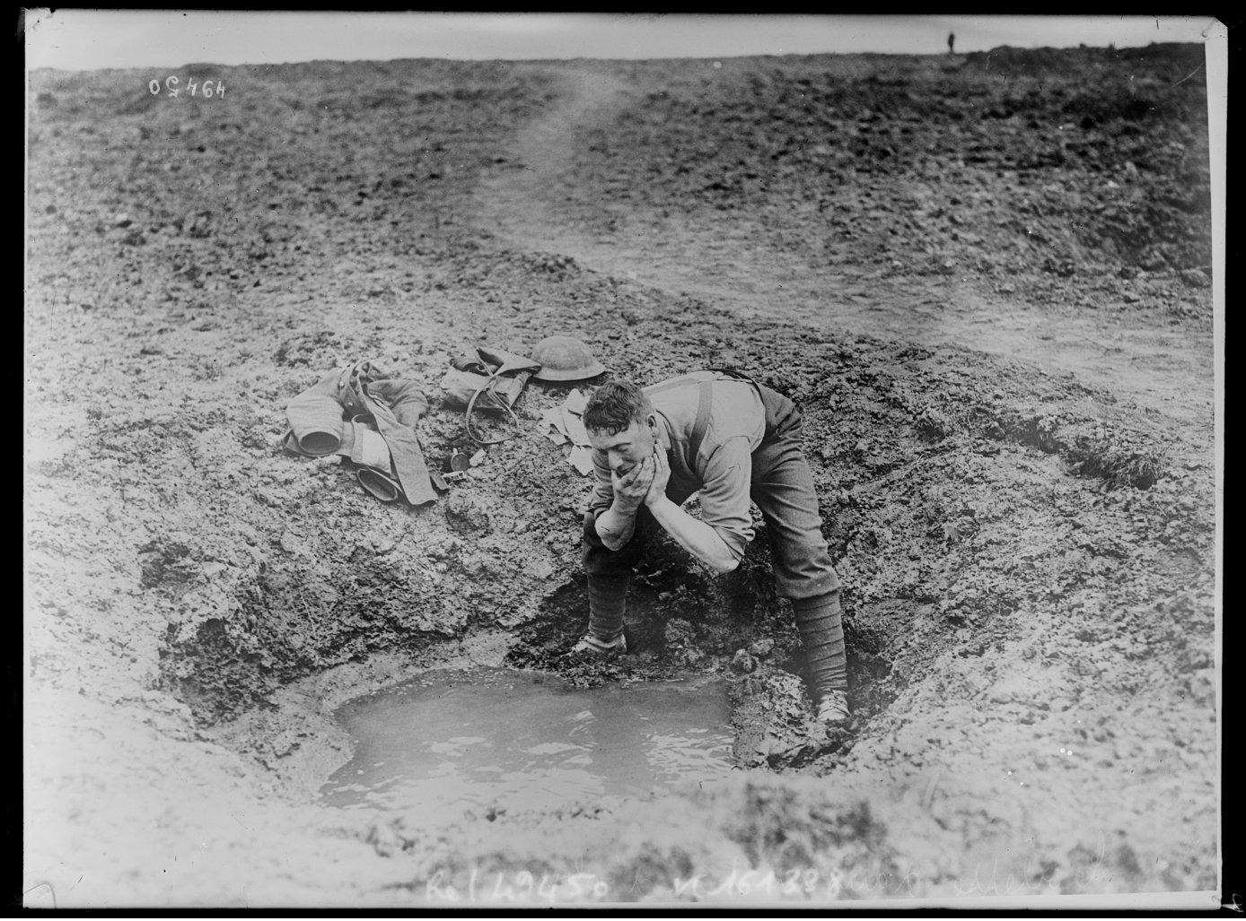
What is happening here?

Slide 4
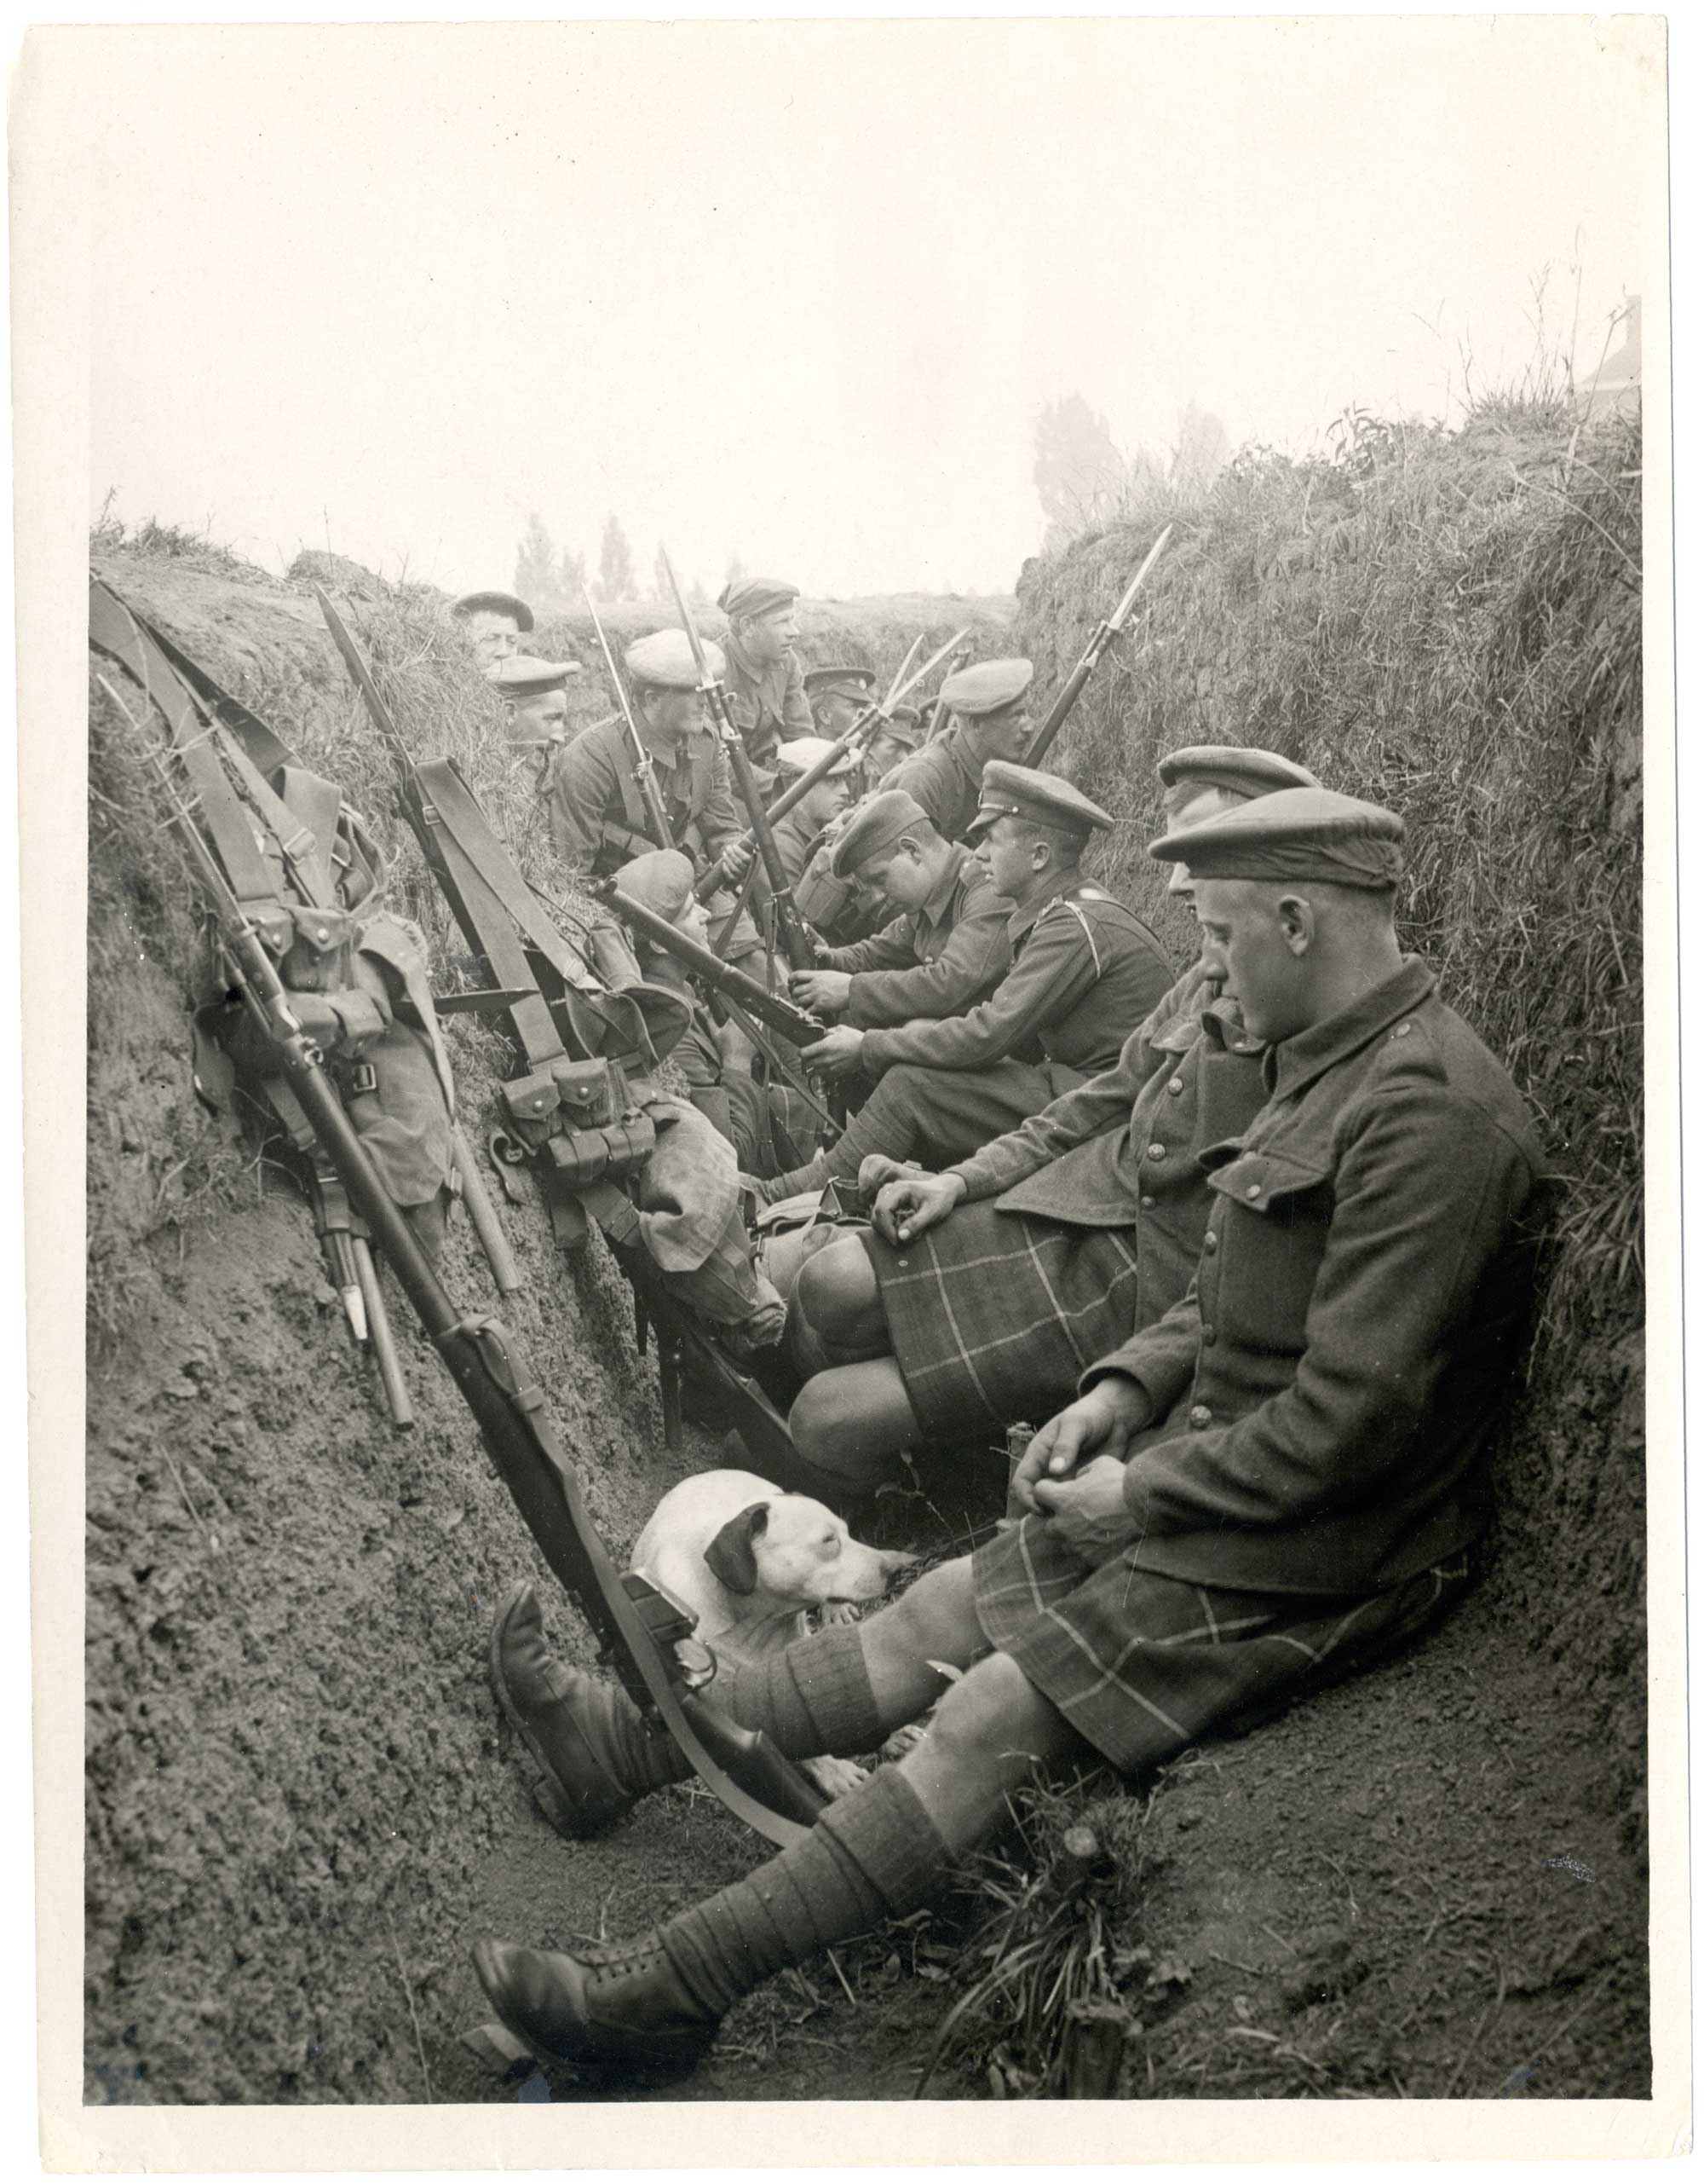
What is surprising about this image?
Where are these soldiers from?

Slide 5

How did the fortunes of the Entente change during the war?
Today I will practice:
How to sort dates into chronological (time) order
How to identify and explain different types of change in History
Last lesson, we looked at why World War I became a battle of trench warfare. Why wasn’t it ‘over by Christmas’?
  G________ M_________
  D__________
  N_______ T___________
  E________ R________.
After the failure of the Schlieffen Plan, the Triple Alliance faced the Triple Entente in a system of trenches that ran all the way from the English Channel and down to Switzerland.
Mostly, trench warfare was a lot of waiting and boredom. Yet also along this line of trenches, and elsewhere, some important battles were fought. This overview lesson will focus on the most important battles of World War I – how did the Triple Entente do? Did their fortunes get better as time went on?

Slide 6
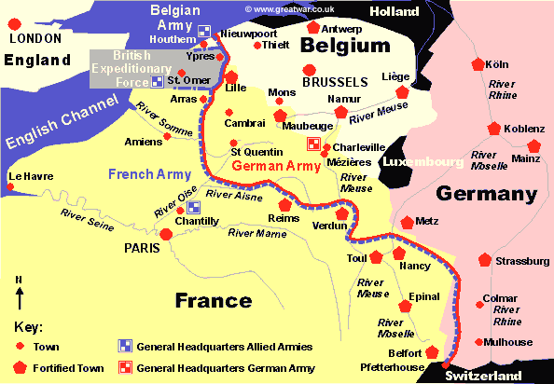

Slide 7
How did the fortunes of the Entente change during the war?
Failure Success
1914
1915
1916
1917
1918
TASK: Record on your chart
Name of the battle
Date of the battle
One sentence summary of the battle
Reason for position on the chart (success/failure/mixed)
Challenge: In a different colour, plot Alliance success/failure for each battle.
When the Entente did badly, did this always mean the Alliance did well?

Slide 8
Self-Assessment:
How did the fortunes of the Entente change during the war?
Failure Success
1914
1915
1916
1917
1918
2
1
3
4
6
5
7
8
9
10

Slide 9
How did the fortunes of the Entente change during the war?
CONCLUDING TASK: Working together as a class, identify which image corresponds to which battle, then place the images in order.

Slide 10
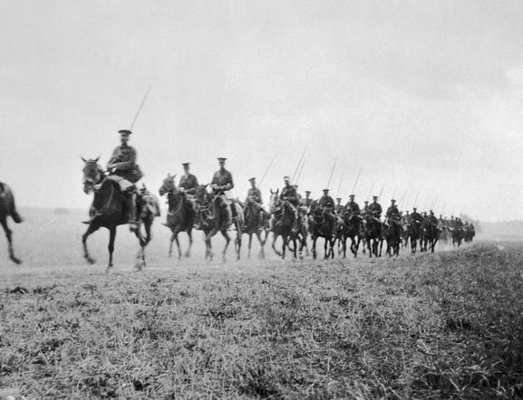
After this battle, where the BEF and the French met the Germans for the first time, the Germans managed to drive the British back to a river just outside of Paris.
Battle of Mons, 23 August 1914

Slide 11
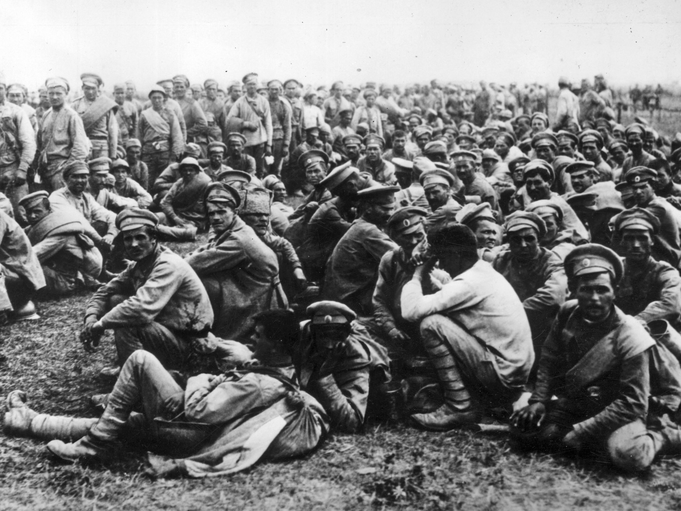
This battle took place early on in the war and was a disaster for the Russians – around 92,000 of them were taken prisoner by the Germans.
Battle of Tannenburg, August 1914

Slide 12
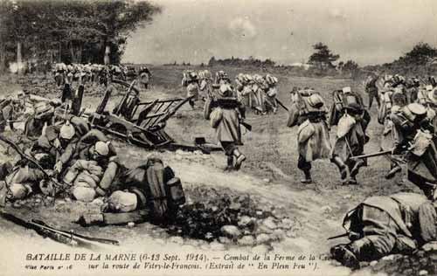
This battle ensured that the Germans were prevented from occupying the whole of France –BEF and French forces stopped them. Yet at a heavy cost. The German army then retreated in good order and dug in…for the long haul.
First Battle of the Marne, 6-10th September 1914

Slide 13
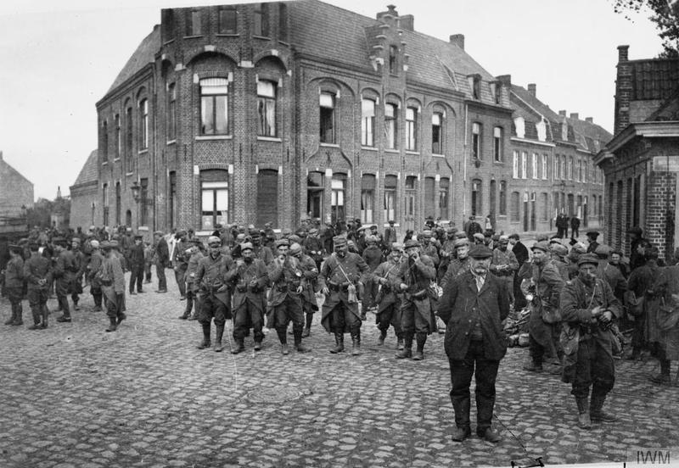
In this battle, the Germans attacked a town near to the sea for four weeks, in order to regain the town as it had important access to channel seaports.
The BEF held on, yet at a huge cost – the BEF was effectively destroyed here.
First Battle of Ypres, Oct-Nov 1914

Slide 14
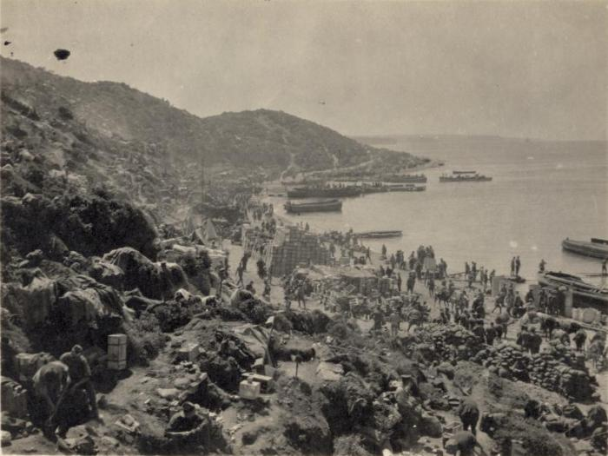
In this drawn-out campaign planned by Churchill, the British attacked Turkey, to try to gain access to Russia through the Mediterranean. Just over 200,000 British men were killed or injured here – and it was almost a complete failure.
Gallipoli Campaign, 1915

Slide 15
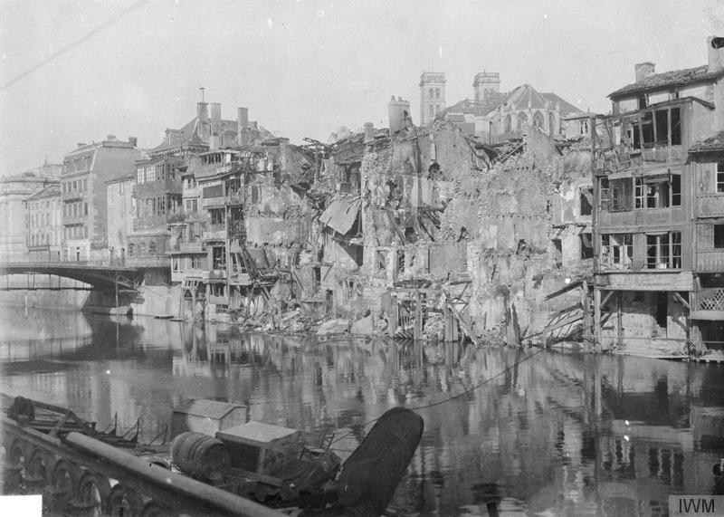
Here, during the longest battle of the First World War, the Germans attacked the strongest part of the French line of trenches, to try to effectively destroy the French army. The French held on, yet lost over half a million men.
Battle of Verdun, Dec 1914-Dec 1916

Slide 16
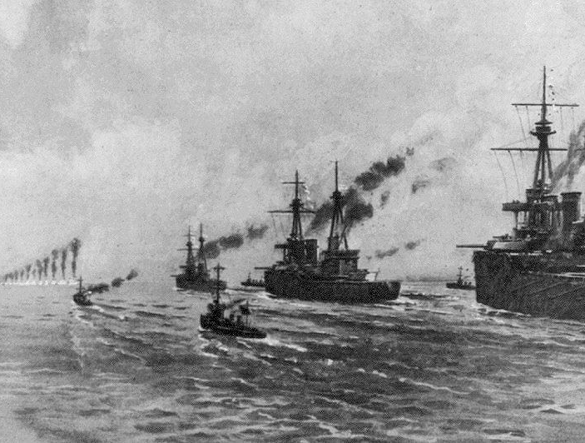
In this battle, the Germans decided to take on the might of the British navy.
The Germans claimed victory (the British lost more battleships), but the battle ensured that the German navy was finished as a fighting force.
Battle of Jutland, May 1916

Slide 17
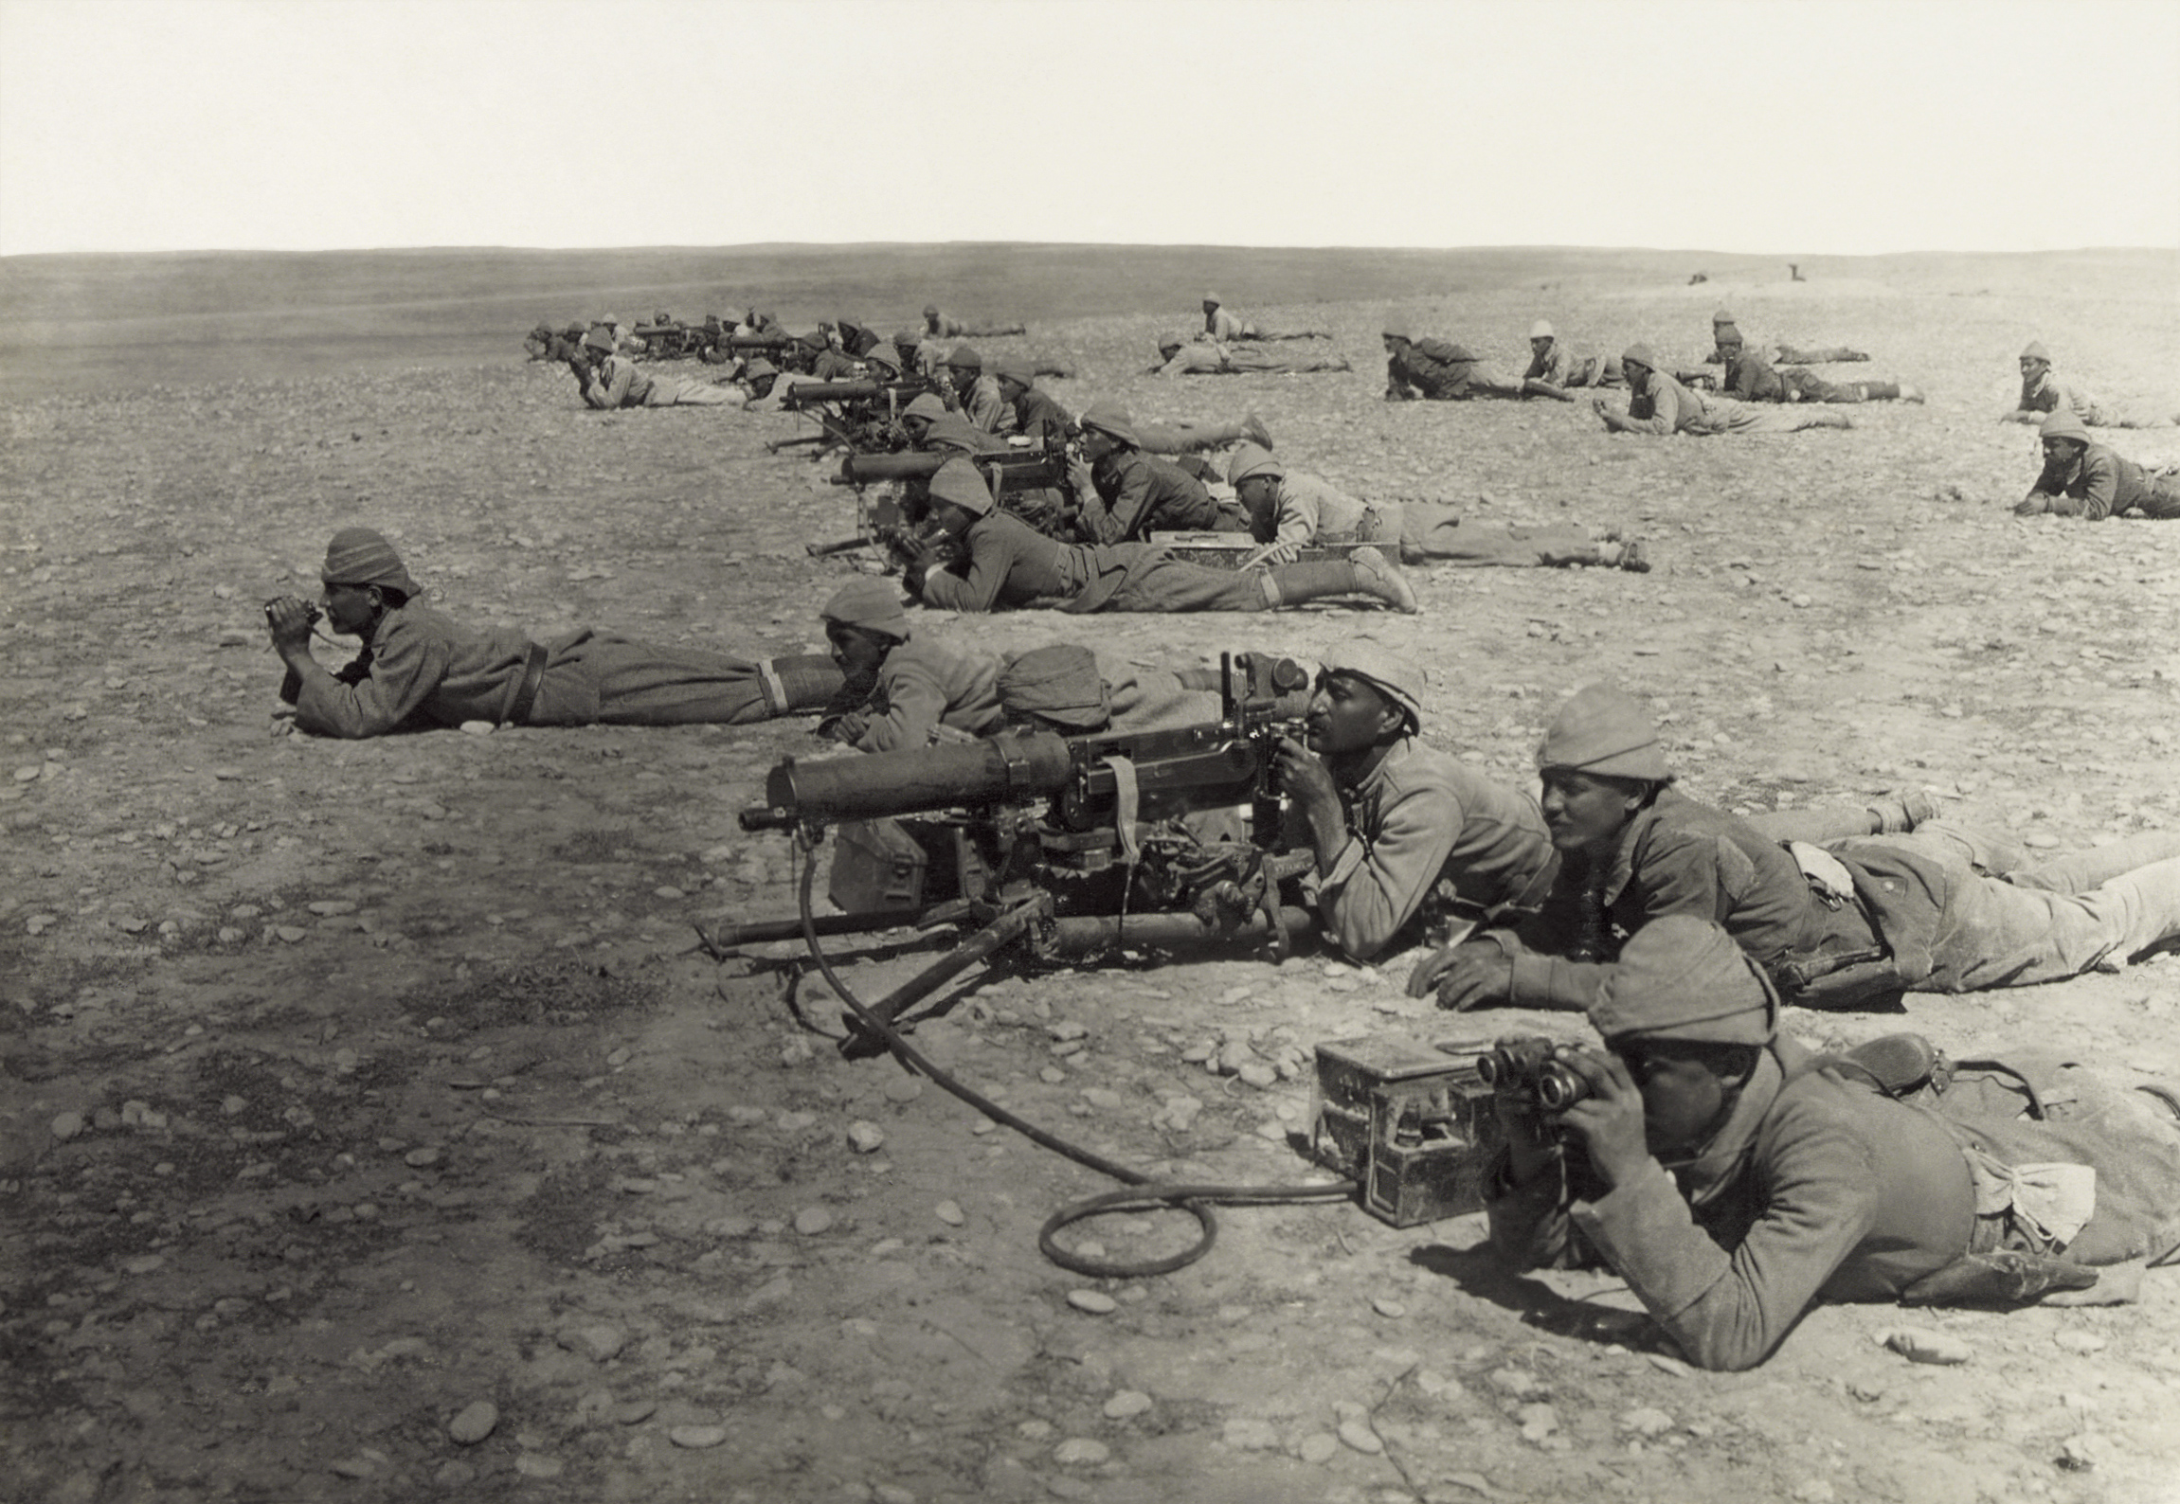
In this battle, the British beat the Turkish army in order to take control of Jerusalem – yet at a very heavy cost, and for no real strategic value.
Battle of Gaza, Summer/Autumn 1917

Slide 18
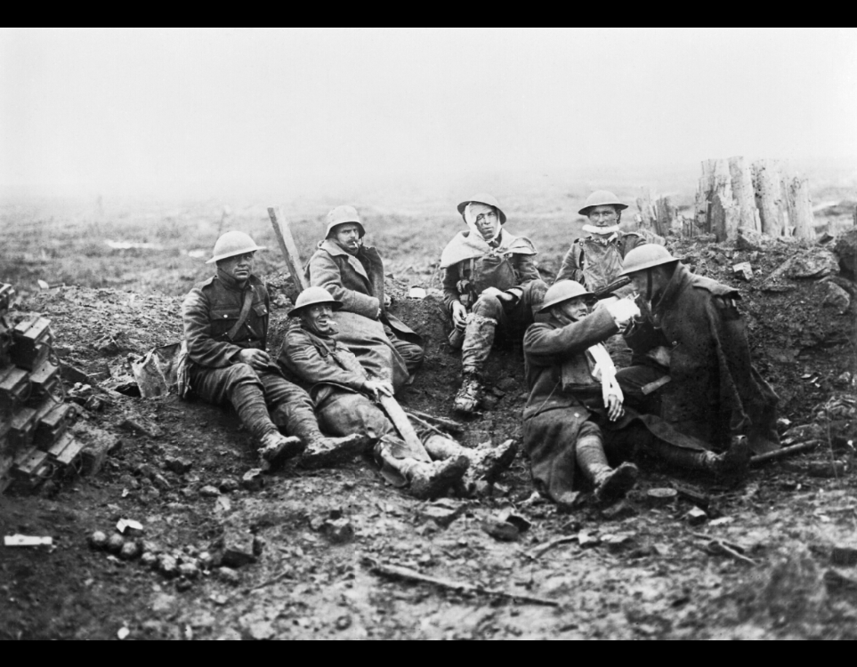
In this battle, British general Sir Douglas Haig attacked the German army, thinking they were close to collapse. The fighting was made even harder by the rains, turning the landscape into a swamp.
Battle of Passchendaele (Third Battle of Ypres), 1917

Slide 19
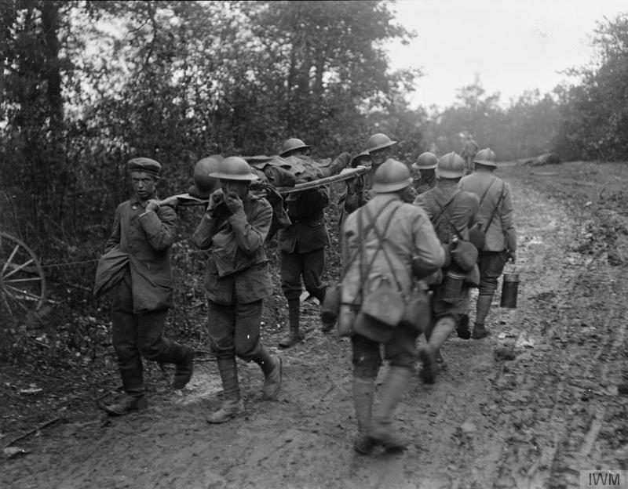
In this battle, British, French and American troops counterattacked against a German offensive. The battle marked the last real attempt by the Triple Alliance to win the First World War.
Second Battle of the Marne, July 1918

Slide 20
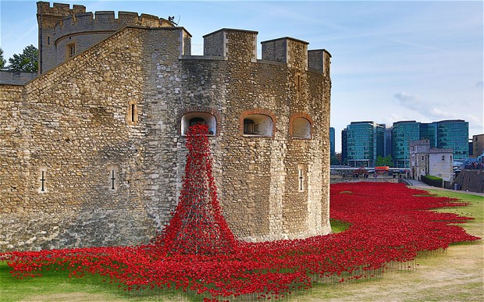
“The British went from total defeat to total success during World War One”.
To what extent do you agree with this statement?

Slide 21
After this battle, where the BEF and the French met the Germans for the first time, the Germans managed to drive the British back to a river just outside of Paris.

Slide 22
This battle took place early on in the war and was a disaster for the Russians – around 92,000 of them were taken prisoner by the Germans.

Slide 23
This battle meant that the Germans were prevented from occupying the whole of France –BEF and French forces stopped them. Yet at a heavy cost. The Germans then retreated in good order and dug in for the long haul.

Slide 24
In this battle, the Germans attacked a town near to the sea for four weeks, in order to regain the town as it had important access to channel seaports.
The BEF held on, yet at a huge cost – the BEF was effectively destroyed here.

Slide 25
In this drawn-out campaign planned by Churchill, the British attacked Turkey, to try to gain access to Russia through the Mediterranean. Just over 200,000 British men were killed or injured here – and it was almost a complete failure.

Slide 26
Here, in the longest single battle of World War I, the Germans attacked the strongest part of the French line of trenches, to try to effectively destroy the French army. The French held on, yet lost over half a million men.

Slide 27
In this battle, the Germans decided to take on the might of the British navy.
The Germans claimed victory (the British lost more battleships), but the battle ensured that the German navy was finished as a fighting force.

Slide 28
In this battle, the British beat the Turkish army in order to take control of Jerusalem – yet at a very heavy cost, and for no real strategic value.

Slide 29
In this battle, British general Sir Douglas Haig attacked the German army, thinking they were close to collapse. The fighting was made even harder by the rains, turning the landscape into a swamp.

Slide 30
In this battle, British, French and American troops counterattacked against a German offensive. The battle marked the last real attempt by the Central Powers (or ‘Triple Alliance’) to win the First World War.

