Slide 1
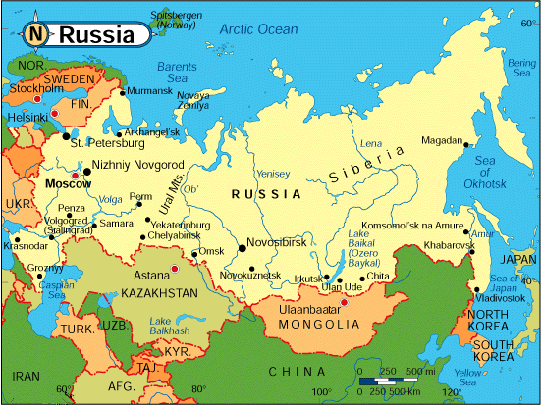
GAME: Why did Tsarist Russia collapse into revolution?

Slide 2
GAME: Why did Tsarist Russia collapse into revolution?
The Russian Empire Game
In groups of 3 or 4 you will decide how to rule your empire, as Tsar and advisers. The winning group will be the one with the largest Imperial Fortune at the end.
Throughout the game, try to identify all the different causes (reasons) as to why the Tsar’s rule collapsed into revolution.
You will have to take on and deal with a lot of information all at once! So listen well.

Slide 3
GAME: Why did Tsarist Russia collapse into revolution?
The point of the game is to rule the Russian Empire well. You must stay alive and stay rich (you need money to sort out all your problems!). You get bonuses by making the right decisions, and you get money by receiving taxes. You will need money though to pay and equip your army and secret service! The amount you pay will change – e.g. if it is wartime.
You will hear a news flash at the start of each round, which will help you to make your decisions. Listen carefully as it will not be repeated!
When you have decided, select the correct ‘Action Cards’ and place them in front of you. You are only allowed to do what you can afford. Thoughtful action points will lead to bonus points, and poor actions will lead to penalties. You die if you ever have 4 more penalties than bonuses.
You can make any action in any round. After Action Cards have been played, you will hear the consequences of your decisions.
The winning group will have the most money at the end so make sure you make the right decisions.
1 coin will be subtracted from any groups talking through the news flashes.
Actions only count for a single round and cannot be brought forward.

Slide 4
GAME: Why did Tsarist Russia collapse into revolution?
Advice:
Try to anticipate troubles and take action to avoid them
Your life is in constant danger- be careful
When things go well, prepare for bad times ahead
Try to keep the loyalty and love of your people

Slide 5
Who do you need to know about?
The Cossacks– You have a fairly large army to protect a large empire. The fierce Cossacks are leaders of the army. You must protect Russia’s borders, and deal with invasions and in-fighting. Peasants can be troublesome when they don’t have enough food and workers’ strikes need to be crushed – brutally! Make sure you pay your Cossacks generously to keep them loyal.
The people of St. Petersburg– they live at the centre of your Empire, and expect you to rule wisely and fairly. They spend a lot of their free time discussing you – make sure they have enough food and vodka so that good things are said! Many of the upper classes want Russia to keep pace with other European countries, so they are interested in industrialisation.
The colonies– these are the areas which have been conquered by your army at the end of the nineteenth century. The people living here pay you taxes and expect to be treated and governed fairly. It is important that they are kept happy, but don’t hesitate to crack down on them if problems become serious.
Revolutionaries abroad– there are people living outside the Empire who have new ideas like ‘democracy’ and ‘freedom of speech’. You have no control over them. Their ideas do a lot of damage when they encourage people in your empire to be critical about your absolute power. When their ideas are found to be influencing people in your empire, don’t be afraid to exile revolutionaries to Eastern Siberia to do forced labour.
The Okhrana– This is your secret police. It involves a network of spies and agents who protect and advise you. They crack down on any opposition to your government and deal swiftly with any newspapers criticising you.

Slide 6
GAME: Why did Tsarist Russia collapse into revolution?
And finally…
Tsars can die as the result of assassination or lose their thrones if they go bankrupt. If this happens, the group must select a new Tsar who starts ruling immediately with a personal fortune of 8.
Dead tsars can still give advice and help through dreams and prophesies as revealed by the ‘Startsy’ (the Holy men)

Slide 7
GAME:
Why did Tsarist Russia collapse into revolution?
Do you have…
A scoresheet?
A map?
Action cards?
Let’s play…!

Slide 8
MAP: Why did Tsarist Russia collapse into revolution?
Background:
Russia was a vast empire spanning two continents - Europe and Asia. It stretched over 4000 miles from West to East and 2,000 from North to South and covered 1/6 of the world's total land. There were few paved roads, earth roads turned to mud in the rain, and many roads became impassable. Travel by rail was only possible in European Russia until 1904 when the Trans-Siberian opened. The empire contained around 130 million people but less than half of the population were Russian. The rest belonged to the peoples who had been conquered by the Russians and It was not until the end of the nineteenth century that many areas in the south and east came under Russian control. Some of the national groups were deeply resentful of Russian control and the policy of ‘Russificiation’.
The Caucasus
Peoples included: Cossacks – fiercely independent warriors living in European Russia who supported the Tsar; ‘White Russians’ – with blond hair and pale skin; The Great Russians – a mixture of Slavs and Vikings; Nenets – who lived like Eskimos in the frozen North; nomadic tribes and reindeer herders in Siberia; Muslim peoples in the South East; and in the Caucasus region, only conquered in 1864, were the Georgians and other national groups including mountain tribesmen like the Chechens, who resisted Russian control.

Slide 9
GAME: Why did Tsarist Russia collapse into revolution?
Collapse of Tsarist Russia

Slide 10
After the fall of Tsarist Russia in the March Revolution (1917) what type of consequences/effects were there?
Consequences for the Tsar
Consequences for the revolutionaries
Helpful Damaging Peaceful
Extreme Upsetting Beneficial
Mild Immediate Subtle
Far Reaching Violent Multi-faceted
Undermining Strengthening Unifying

