Slide 1
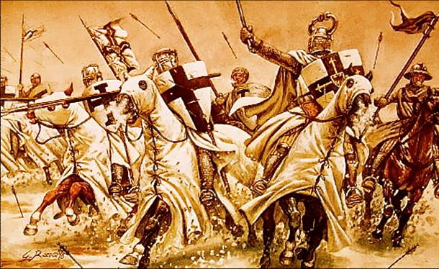
The First Crusade: a very simple introduction

Slide 2
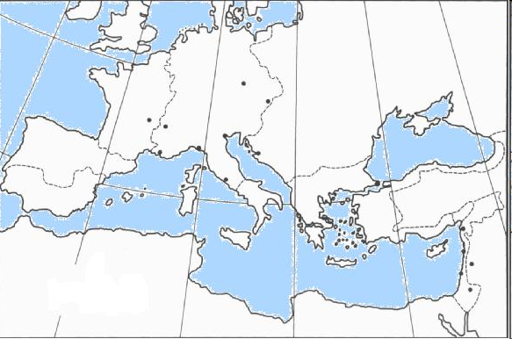
6
Spain
Greece/
Turkey
5
Asia Minor
1
3
Holy
Land
4
2
Label the following: England, [France], [Italy], [North Africa], Holy Roman Empire

Slide 3
The Crusades Game
During every round of the game, you will listen to a newsflash.
This newsflash will tell you about an event that took place before or during the Crusades.
You have two jobs to do after reading each newsflash:
Identify the place (shown in bold) on the map and write down the location number on this scoresheet.
Decide what you want to do next – you will be given points for doing the right thing, or if you make the wrong decision, you might die… write down your decision on the scoresheet.
Team Name:
Newsflash | Where are you? (e.g. 7) | Decision (e.g. A) | Points Scored (Tally)
1
2
3
4
5
6
Total Points:

Slide 4
Newsflash 1: The Crusades
It is 1095. It is just under thirty years since William of Normandy conquered England (1066), and became King of England.
You are a knight, living in Normandy, and you have been given land by William to reward your family for fighting for him in the Battle of Hastings. The nearest town is Rouen, and you attend church here. It is in Rouen, at church, that you bump into your old friend, Antoine.
Antoine tells you about the latest news – which has taken 10 weeks to get here from the Middle East – that Muslim-controlled Jerusalem has been taken over by Seljuk Turks (a different Muslim group), who are not allowing Christians to enter the city.
Your reaction to this news is…
  To celebrate! You, as a Christian living in Normandy, hate Muslims and so it’s much better to not visit a Muslim city
  To not be bothered. Jerusalem is about 2,500 miles away – who cares?
  To be angry! Jerusalem is a holy city, and Christians should be allowed to worship there.

Slide 5
Germany
Normandy
Spain
Greece/
Turkey
5
Asia Minor
1
3
Holy
Land
4
2
2 Points if you correctly identified location number 6

Slide 6
1: The Results
A (celebrate): no one else is happy - Jerusalem is the birthplace of Jesus, the son of God! People are outraged that you could be happy that you can no longer visit Jerusalem. You are thrown out into the street and excommunicated (sent to hell when you die). 0 points.
B (not bothered): you are the only person who isn't bothered by this news - people need to be able to visit Jerusalem to pray at the tomb of Jesus! Then some of their sins can be forgiven. You are the only one to leave the Church, whilst everyone else stays to hear more, and whilst you live, you take no further part in the crusades. 1 point.
C (angry): of course you are angry! Although Muslims think Jerusalem is sacred, you are such a strong Christian that you feel you must get Jerusalem back. 3 points.

Slide 7
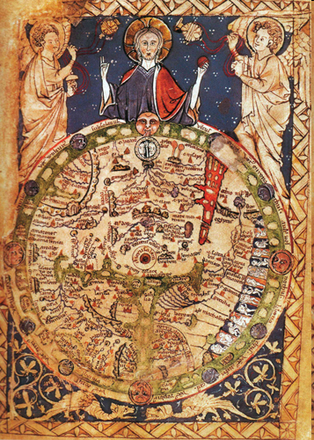
Jerusalem was the most important place in the world for Christians because Jesus was born there and was buried there.
How can we tell from this Medieval map that Jerusalem was very important?

Slide 8
Newsflash 2: The Crusades
As you are talking with Antoine, the fat priest comes almost running down the transept. “It’s a message from the Pope!” he declares, “He wants men to go on Crusade to fight the Muslims and regain Jerusalem for Christianity!” You wait, anxiously, while the priest catches his breath.
“The Pope has said that Muslim Turks (‘Saracens’) have been killing many Christians and have destroyed Christian Churches. The Pope says France is overcrowded and the Holy Land can provide wealth and new homes. He is going to go on a tour around all the Churches of France to try and persuade knights to travel to the Holy Land and to free Jerusalem from the Muslims – and that’s not all! He has said something really amazing which means that everyone will want to go on crusade!”
What do you think the Pope has said?
  If you go on Crusade, he will shower you with wine and gold
  If you go on Crusade, he will let you marry more than one woman
  If you go on Crusade, all your sins will be forgiven and you will be guaranteed a place in heaven.

Slide 9
Germany
6
Spain
Greece/
Turkey
5
Asia Minor
1
3
Holy
Land
4
Jerusalem
2 Points if you correctly identified location number 2

Slide 10
2: The Results
A (for wine and gold): you have enough wine and enough money after William gave you all of your land in Normandy! Travelling to Jerusalem would cost you a fortune anyway – probably much more money in horses, horseshoes and suits of armour than you could get back. 1 point.
B: (marry more than one woman): don’t be silly the bible says that this is wrong! You can only ever marry one woman. 0 points.
C (go to heaven): wow, a chance to kill people (which is your job as a knight) AND get a guaranteed place in heaven? This is too good to be true – and an offer you can't refuse. 3 points.

Slide 11
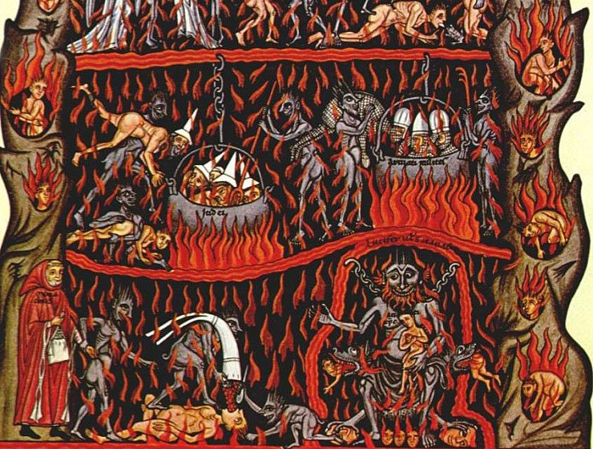

Slide 12
Newsflash 3: The Crusades
A month later, the Pope visits Rouen. You are signed with the cross and make preparations to travel to Jerusalem. You spend lots of money buying chainmail, horses and supplies. 60,000 people set out in the summer of 1096, a year after you started your preparations.
Your band of men is led by a man called Duke Robert, who tells you that all the crusaders are to assemble in Constantinople (now called Istanbul) by the spring of 1097. Constantinople is a Christian city, but is ruled by an Emperor and not the Pope. The people there follow the Greek Orthodox Church – a different church to your own. The Emperor says that all lands taken from the Muslims by the Crusaders must be returned to him. Your reaction to this demand is:
  You accept. He used to own the land so he should have it back. You don’t want to annoy the emperor, as he owns the city where you’re staying.
  You say ‘yes’ to the emperor’s face, but then plan to go back on your word once you’ve left the city and captured the land. You captured it – so you should have it, on behalf of your leader, the Pope.
  You say no. The land should go to the Pope instead. He was the man who set up the Crusade, and he is God’s representative on earth.

Slide 13
Germany
6
Spain
Constantinople
Greece/
Turkey
Asia Minor
1
3
Holy
Land
4
6
2 Points if you correctly identified location number 5

Slide 14
3: The Results
A (accept what the Emperor asks) having assured the emperor that you will give back any land you re-take from the Muslims, he is happy, and gives you some supplies, but he doesn’t give you anyone from his own army to help you. The crusaders think you're a bit soft to make a promise to someone who isn't your leader and you have problems dealing with discipline in your army after this. 1 point.
B(accept, but plan not to do it) deceitful, but cunning. You manage to reassure the emperor and get some supplies for your journey, but you also show your men that you are still loyal to the Pope. 3 points.
C (refuse what the Emperor asks) because you refused the oath, you are attacked by the emperor's soldiers in the night. You die. 0 points.

Slide 15
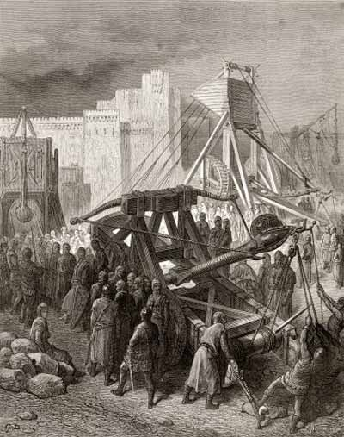
Newsflash 4: The Crusades
In the Spring of 1097, you cross into Asia Minor, and into Muslim territory. The land is very dry and desert-like. In May, you begin the siege of Nicaea, a town in Asia Minor. You want to take the city quickly. It is this next decision, that ensures that you are successful against the Muslims…use the ‘attacking a castle’ sheet to help you make your decision…
  Use miners to dig underneath the towers, so that they collapse. Then enter the city and attack the defenders.
  Use all your forces together to make a direct assault on the city. Using all your forces at once should make sure that you are successful.
  Construct a series of siege towers to help your forces to make an attack over the castle walls.
  Use the trebuchets that you brought with you from Constantinople to destroy the castle walls.

Slide 16
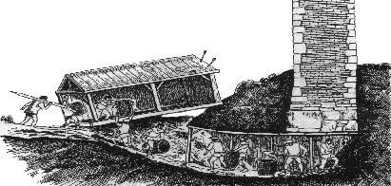
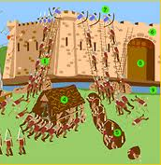
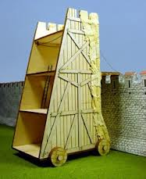
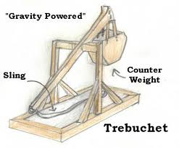
Attacking a Castle
To conquer a territory, an attacking army would have to strike and take the castles that were used to control the local area. To do so, they would launch a siege.
1. Tunnel
Men called “sappers” dug tunnels to gain entrance to a castle and thereby launch a sneak attack, but more often, these miners dug tunnels beneath a castle wall to destabilize and topple it. To defend themselves, castle dwellers put out a bowl of water and watched for ripples that might indicate digging. Also, digging tunnels took a long time which allowed time for defenders’ reinforcements to arrive.
2. Direct Assault
A direct assault was the most dangerous way for attackers to try to take a castle. Soldiers either scaled walls with ladders or overran castle walls breached by tunnels, battering rams, or cannons. Archers and crossbowmen would cover soldiers while they tried to break a wall. Defenders, perched on the castle wall or in narrow windows called loopholes, literally had the upper hand. Archers rained arrows down on attackers.
3. Siege Tower
Attackers sometimes built a siege tower to scale the castle walls. Soldiers lay in wait inside the structure as others wheeled it to the castle. Once there, the soldiers lowered a drawbridge at the top of the tower onto the castle wall. Siege towers were difficult and time-consuming to build, however, and castle defenders could burn them down with fire arrows.
4. Trebuchet
During a siege, these missile launchers relied on a huge counterweight that swung a long arm. When the counterweight was dropped, the device launched a missile from a sling at the end of the arm. Trebuchets could launch missiles hundreds of yards in large, lobbing arcs at or even over a castle wall. Sometimes they even shot out the severed heads of enemy soldiers. If a trebuchet was set up too close to a castle, archers would harass its builders with arrows and catapults would be shot from the castle wall to destroy the trebuchets.

Slide 17
Germany
6
Spain
Greece/
Turkey
5
Asia Minor
Nicaea
3
Holy
Land
4
6
2 Points if you correctly identified location number 1

Slide 18
4: The Results
A (mining): digging a mine takes weeks, and 70% of your troops die from starvation in the meantime (there is little food to find in the desert around you). You are able to topple one wall, but this is quickly repaired. The rest of your army return home, broken-hearted and heavily in debt. 1 point.
B (direct assault): 90% of the troops die in the attack, as the defenders rain arrows down upon your crusaders from the city walls. 0 points.
C (siege towers): you find enough wood in the land around you to make one siege tower, but that's it. This is the desert, remember? The siege tower allows 20 soldiers to cross onto the city walls before it is burnt down. The 20 soldiers are taken prisoner. 1 point.
D (trebuchets): a great idea. The trebuchets are effective against the city walls and you are soon able to get your army inside. 3 points.

Slide 19
Newsflash 5: The Crusades
After the successful siege of Nicaea, the Muslim opposition crumbles away before you. You continue your journey. Soon, you are far enough East, and so you head South for some miles, where you reach Antioch, the first big city that you need to take in the Holy Land.
You agree that this city is too big to take by force, so you decide to starve out the city. But the city continues to receive supplies in secret. Soon, you run out of food. People are having to eat their own horses just to stay alive and not starve! What will re-motivate your troops and give them the courage needed to take this city?
  Force all of your troops to make a full-scale assault on the city.
  Split your troops into two – one part will stay and continue to try and stop supplies coming into the city, and the other will turn back and try to get reinforcements from the Christians in Constantinople.
  Ban all gambling and drinking, and, using a piece of wood you found beneath the city, say that you have found the spear that stabbed Christ’s side when he was dying on the cross.

Slide 20
Germany
6
Spain
Greece/
Turkey
5
Antioch
1
Holy
Land
4
6
2 Points if you correctly identified location number 3

Slide 21
5: The Results
A (direct assault): about half of the men start attacking, yet the other half run away back home to Europe. You don't have enough men to continue your journey to Jerusalem (most of them have now died in the direct assault or have deserted you) and so you have to return home. 0 points.
B (split and find reinforcements): by splitting your forces you have split your strength. The soldiers returning to Constantinople are ambushed and killed. You don't have enough men to continue your expedition and so have to return home. 0 points.
C (find the cross): what a stroke of genius to go back to the original reason why people went on crusade (religion) and remind the army what they are fighting for. Your army's newfound energy and determination ensure you are victorious. 3 points.

Slide 22
Newsflash 6: The Crusades
Now you have taken Antioch, the way is clear for you to continue your journey on to Jerusalem! You head South, and before you know it you have reached Acre, on the coast. Here, you stop to receive supplies from Italy, before continuing on to lay siege to Jerusalem.
Jerusalem is taken in less than a month. You have secured the holiest of places for the Christian world! You can enter the sacred city! What do you do next?
  Kill everyone you find, to prevent them taking up weapons against you, and to take revenge on the Muslims who stopped Christians from entering the city.
  Kill only those people who fight against you, and leave the rest alone – they should get the message.
  Tell everyone to leave the city who isn't Christian.
  Leave everyone be but declare a new, Christian government of Jerusalem.

Slide 23
Germany
6
Spain
Greece/
Turkey
5
1
3
Holy
Land
Acre
6
2 Points if you correctly identified location number 4

Slide 24
6: The Results
A (kill everyone): the streets are soon running with rivers of blood. The more women and children you kill, the angrier the people living in Jerusalem become. They become more and more determined to fight, and you die at the hand of a vengeful Muslim. 0 points.
B (kill those who fight against you): a sensible, war-like decision. Although nowadays unethical, in the Middle Ages, no one respected a warrior who wasn’t prepared to kill, and the Pope said that you were allowed to – this makes an example of the people who fight back. People soon submit. 3 points.
C (tell everyone to leave): on dear! They leave, but 2 days later, return with reinforcements, and put you under siege. Two weeks later, they have retaken the city. 1 point.
D (declare a new government): people abide by the rules of your new government for the first month or two, but a Muslim resistance movement builds, and soon you are attacked within the city walls, and your troops are forced to retreat to outside Jerusalem. 1 point.

Slide 25
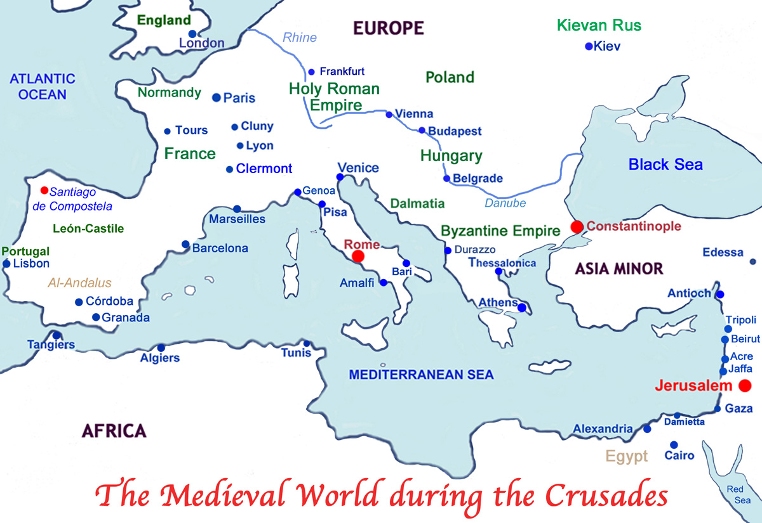
After the success of the First Crusade, which allowed the crusaders to conquer much of the Holy Land, a Second Crusade was launched, to re-capture Edessa. Then, in 1187, Jerusalem was taken back by the Muslims, under a new leader…

